Slide 1
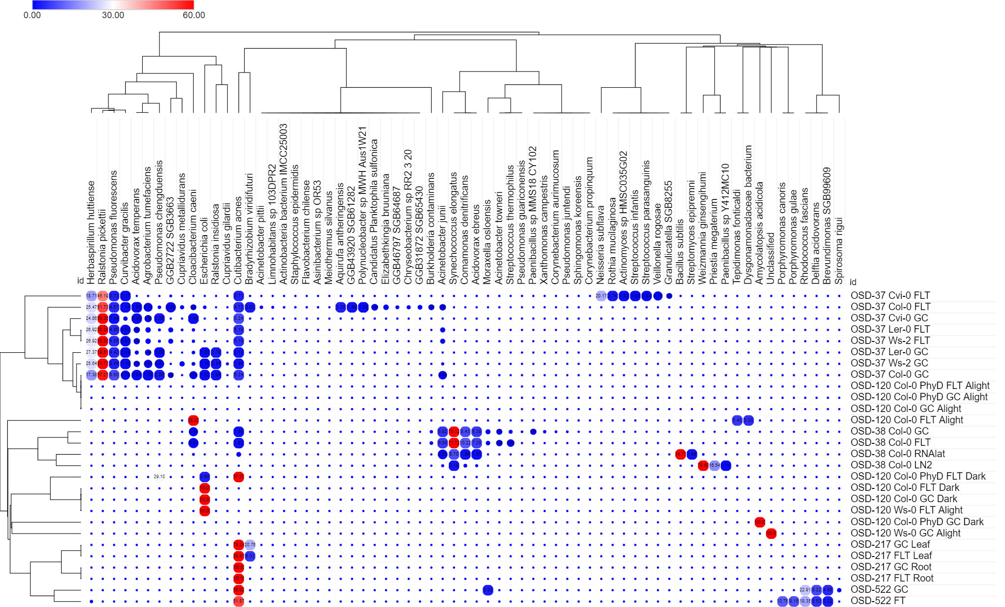
Summary heat map of microbes

Slide 2
Summary stacked bar chart map of microbes

Slide 3
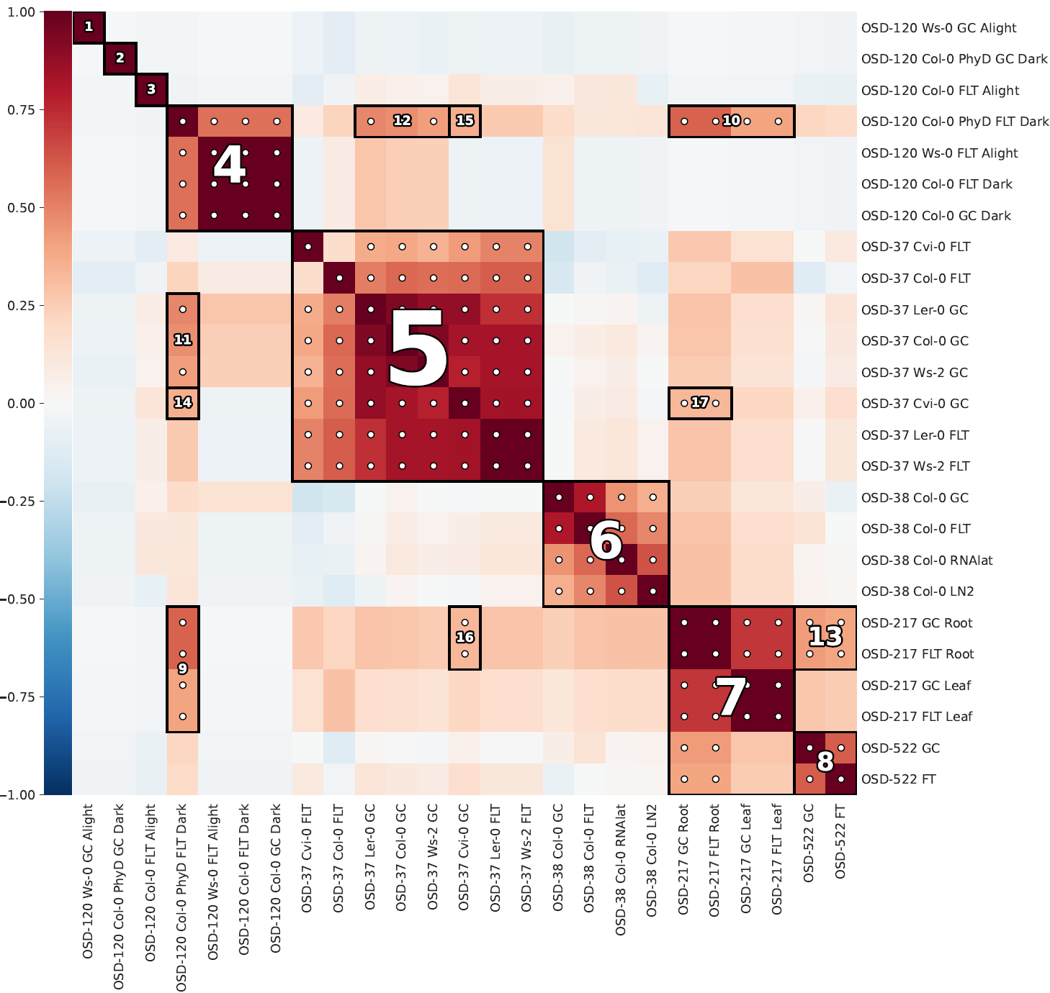
Summary HAIIA (Hierarchical All-Against-All Association) analysis

Slide 4
OSD-120

Slide 5
Ws-0
Col-0
FLT
GC
PhyD FLT
PhyD GC
FLT
GC
Alight
Alight
Alight
Alight
Alight
Alight
X
X
X
E. coli 100%
Unclassified 100%
C. caeni 88.2%
T. fonticaldi 6.4%
D. bacterium 5.3%
Dark
Dark
Dark
Dark
Dark
Dark
X
X
C. acnes 67.2%
chengduensis 29.1%
E. coli 3.6%
A. acidicola 100%
E. coli 100%
E. coli 100%

Slide 6
Bacteria – Col-0 PhyD FLT – Col-0 PhyD GC – Col-0 FLT – Col-0 GC Alight
a)
b)
c)

Slide 7
Bacteria – Col-0 PhyD FLT – Col-0 PhyD GC – Col-0 FLT – Col-0 GC Dark
b)
a)
b)
a)
c)

Slide 8
Bacteria - Ws-0 GC – Col-0 PhyD GC – Col-0 GC Alight and Dark
a)
b)
c)
d)

Slide 9
Bacteria - Ws-0 FLT – Col-0 PhyD FLT – Col-0 FLT Alight
a)
b)
c)

Slide 10
Bacteria - Ws-0 FLT – Col-0 PhyD FLT – Col-0 FLT Dark
a)
b)
c)

Slide 11
Bacteria - Ws-0 FLT –Ws-0 GC Alight
a)
b)
c)

Slide 12
Bacteria – Col-0 FLT – Col-0 GC Alight
a)
b)
c)

Slide 13
Bacteria – Col-0 FLT – Col-0 GC Dark
a)
b)
c)

Slide 14
Bacteria – Col-0 PhyD FLT – Col-0 PhyD GC Dark
a)
b)
c)

Slide 15
OSD-37
Col-0 (GC-FLT), Cvi-0 (GC-FLT), Ler-0 (GC-FLT),and Ws-2 (GC-FLT)

Slide 16
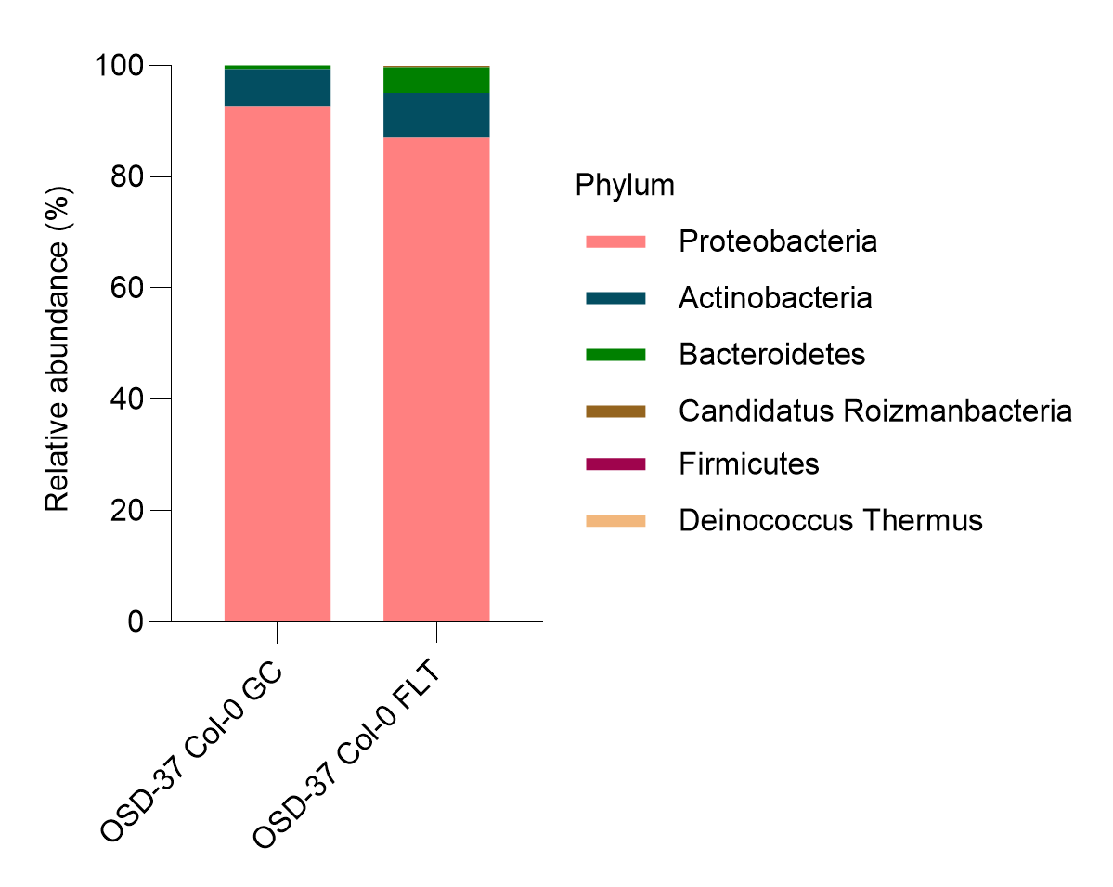
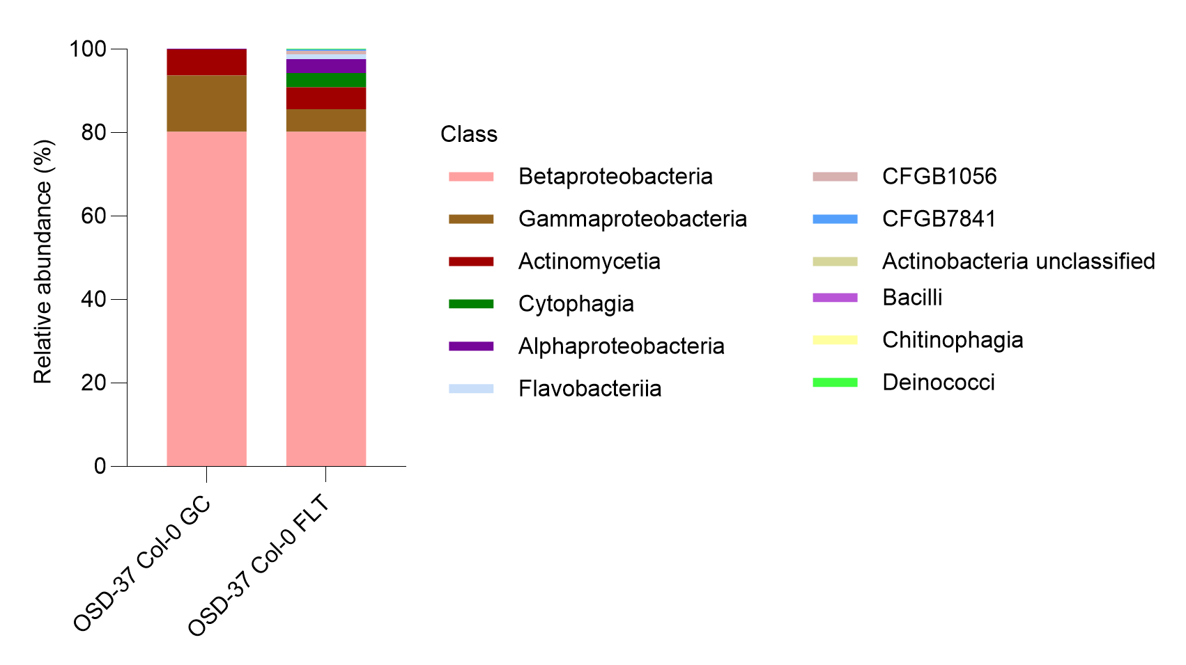
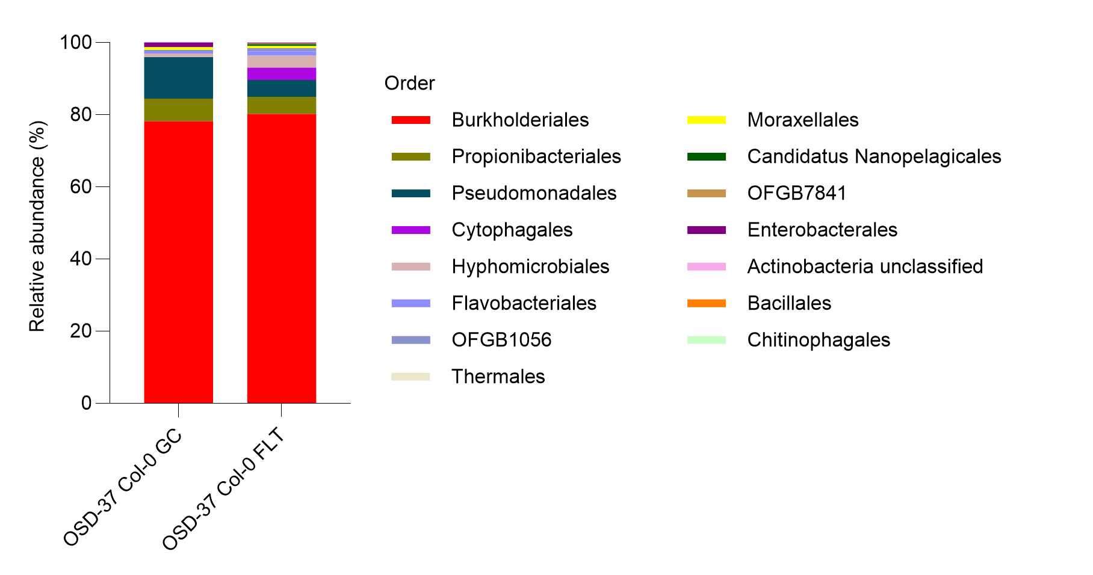
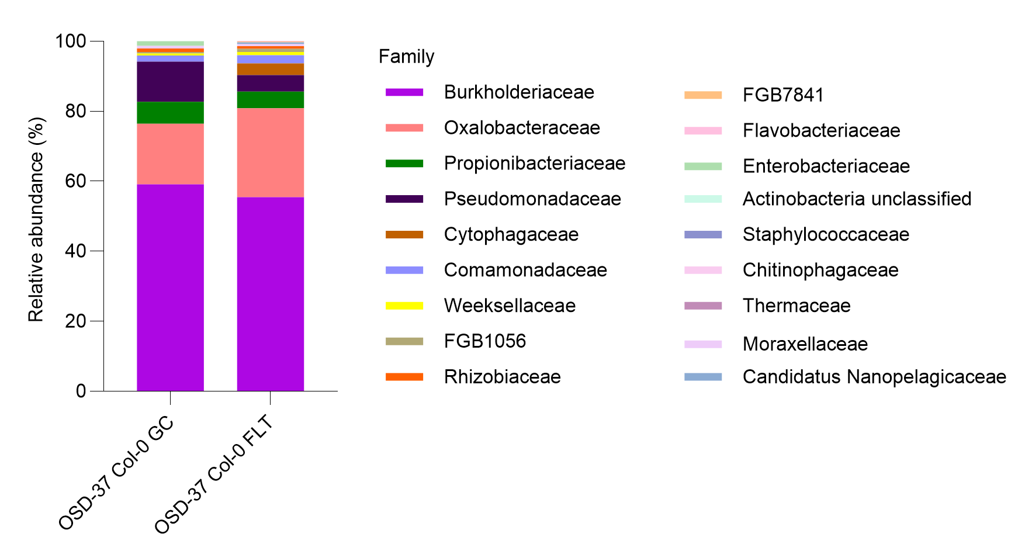
Bacteria - Col-0 (GC-FLT)
a)
b)
c)
d)
https://www.nature.com/articles/nmeth.2066

Slide 17
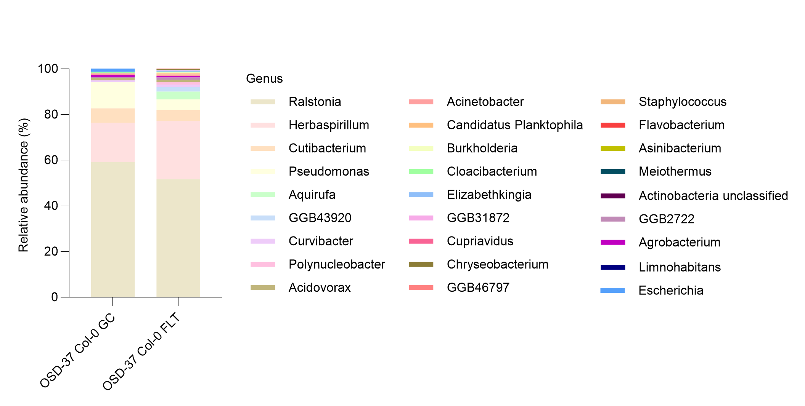
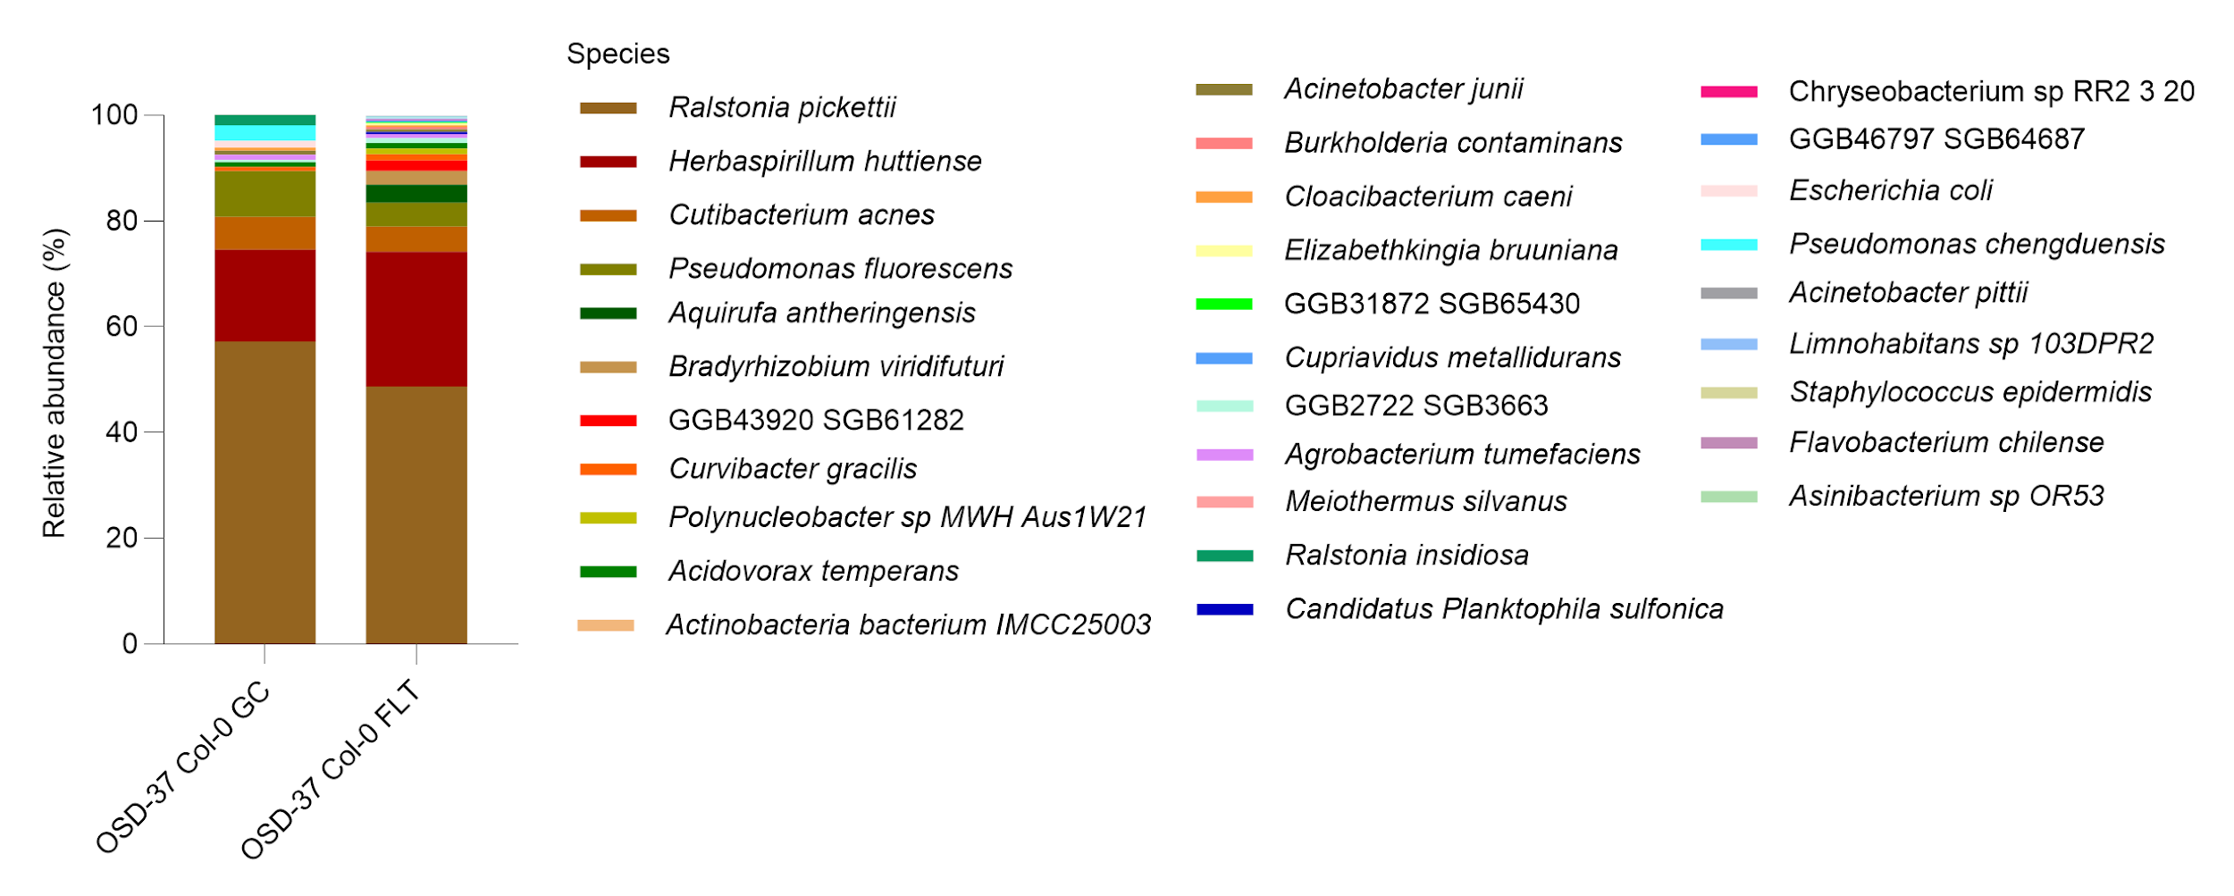
Bacteria - Col-0 (GC-FLT)
e)
f)
https://www.nature.com/articles/nmeth.2066

Slide 18
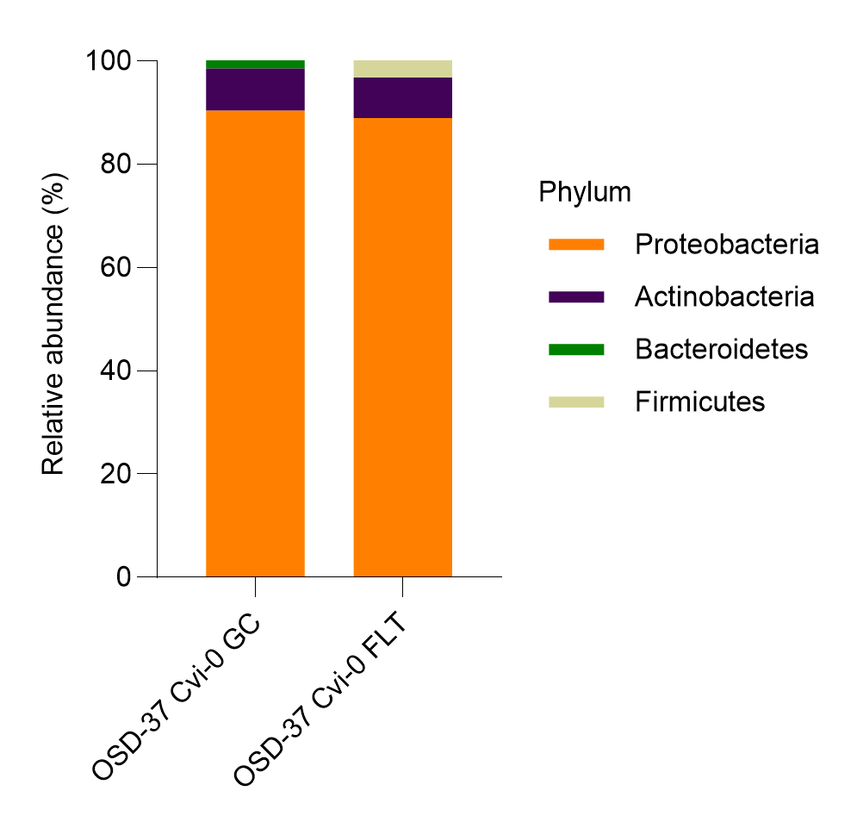
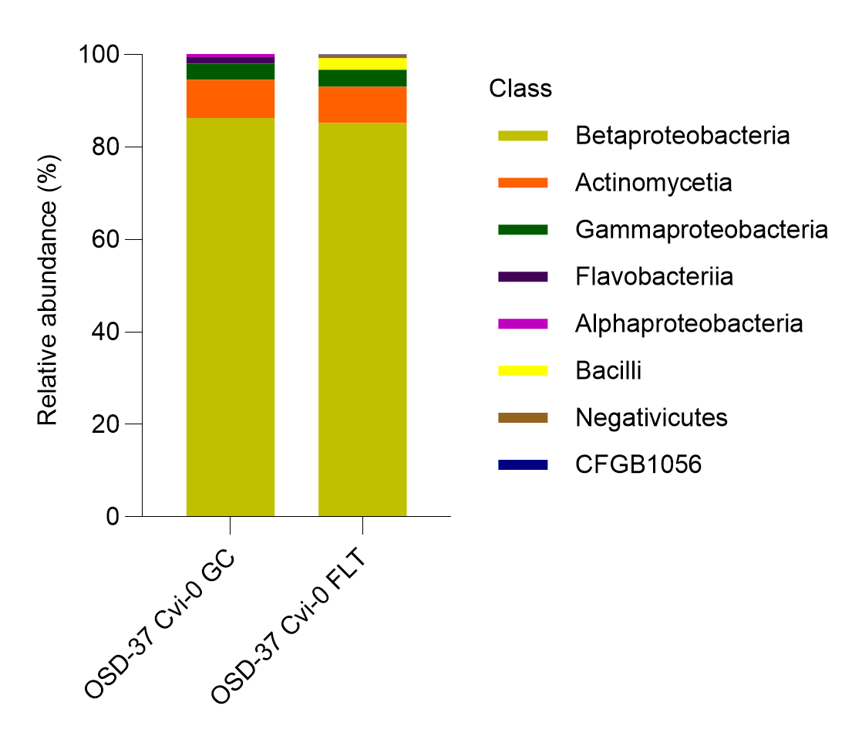
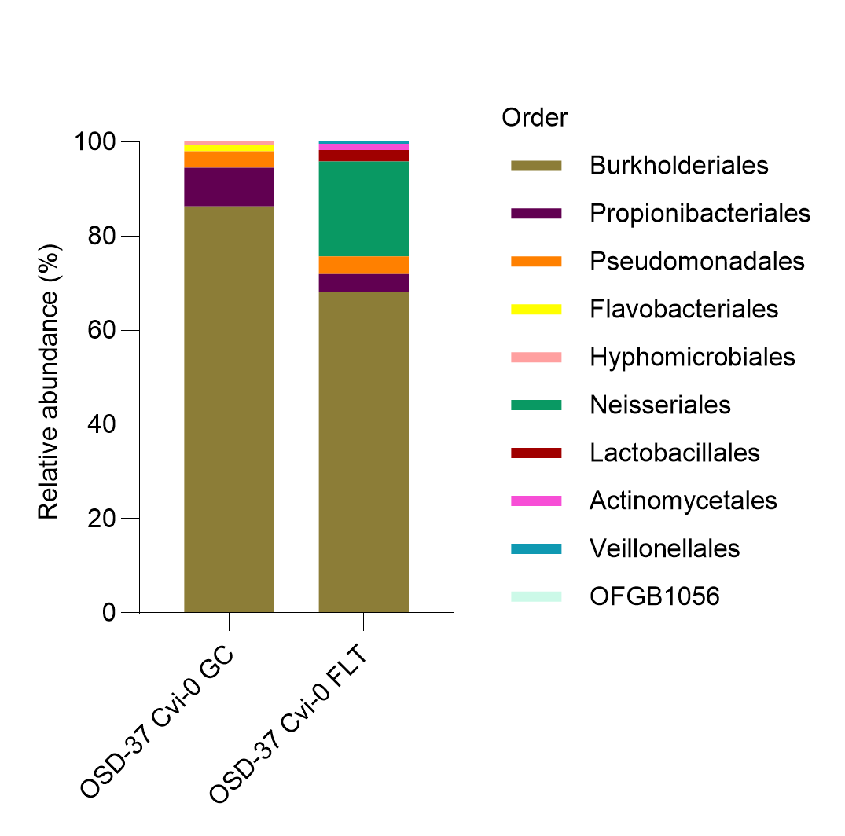
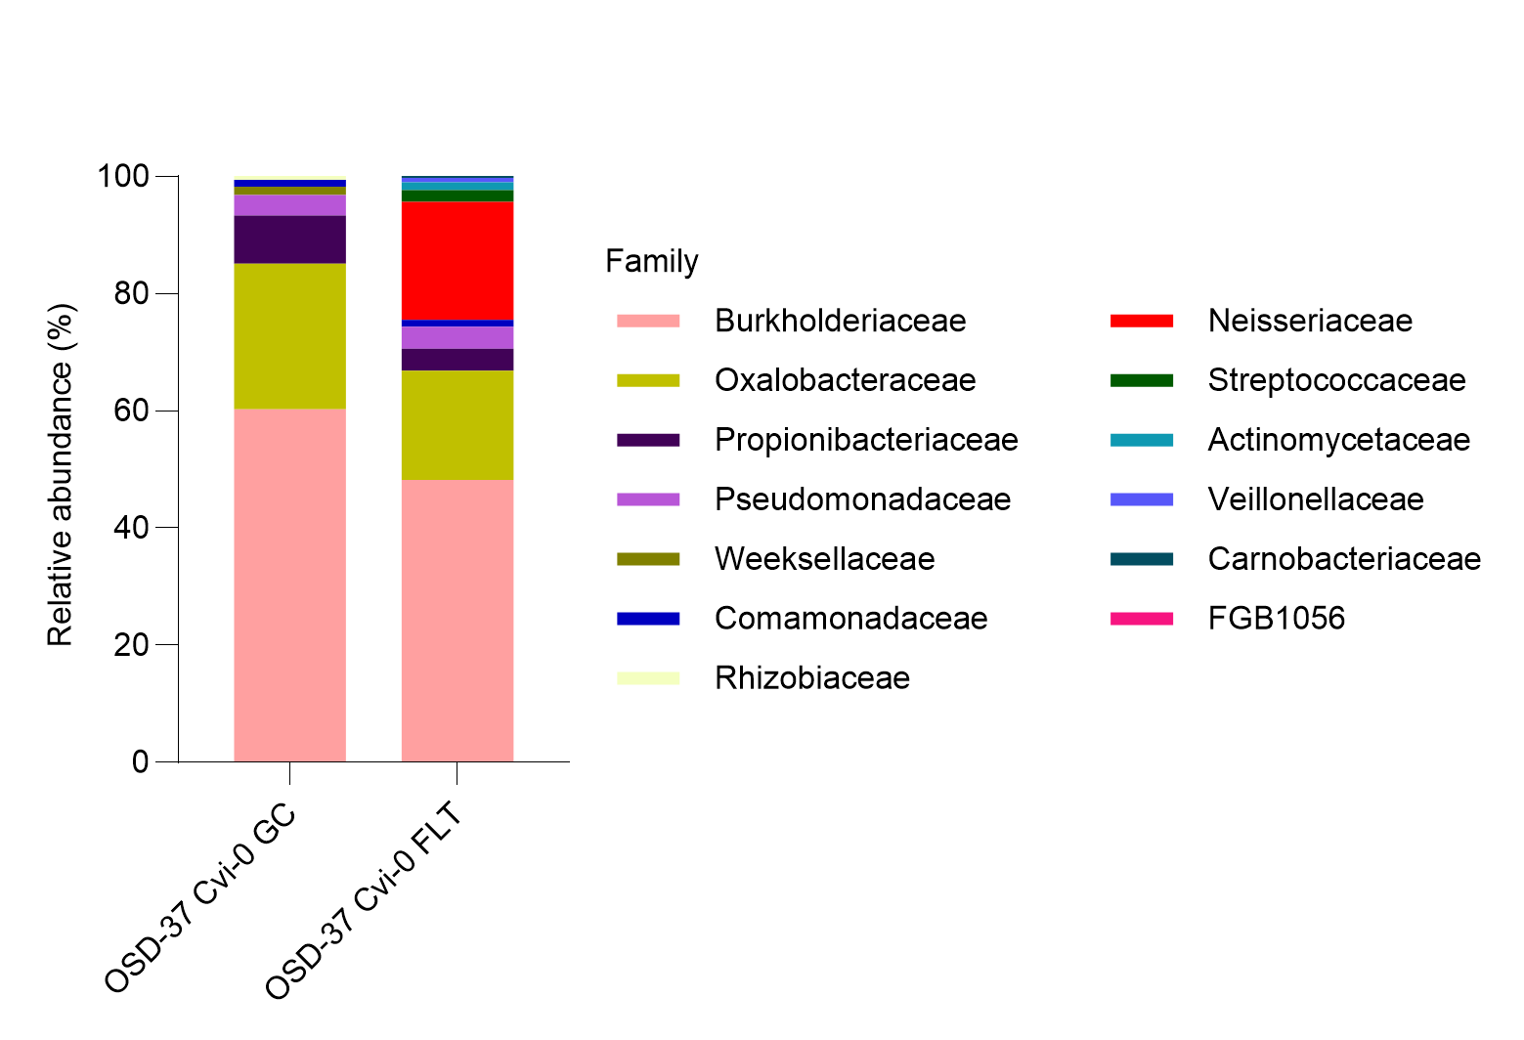
Bacteria - Cvi-0 (GC-FLT)
a)
b)
c)
d)
https://www.nature.com/articles/nmeth.2066

Slide 19
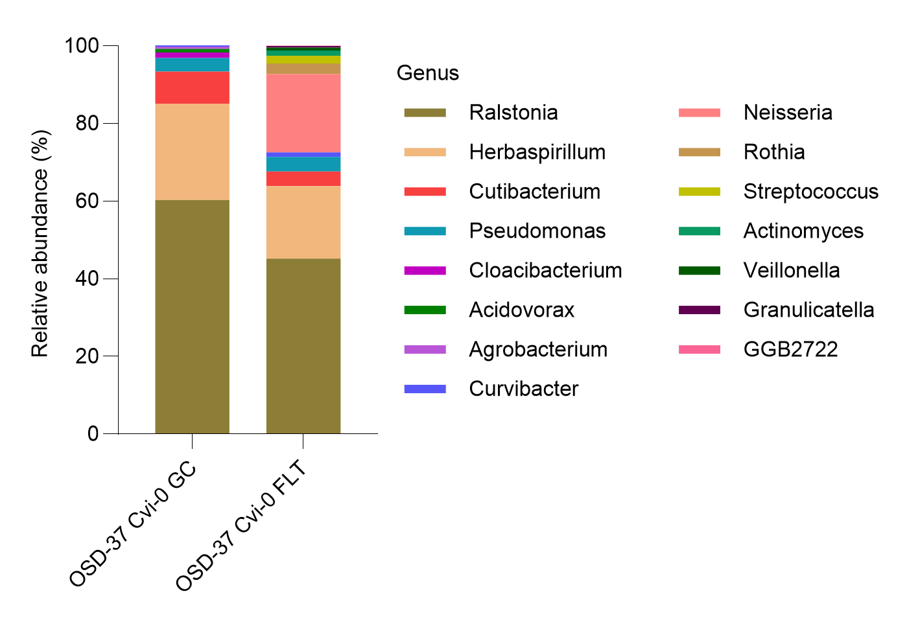
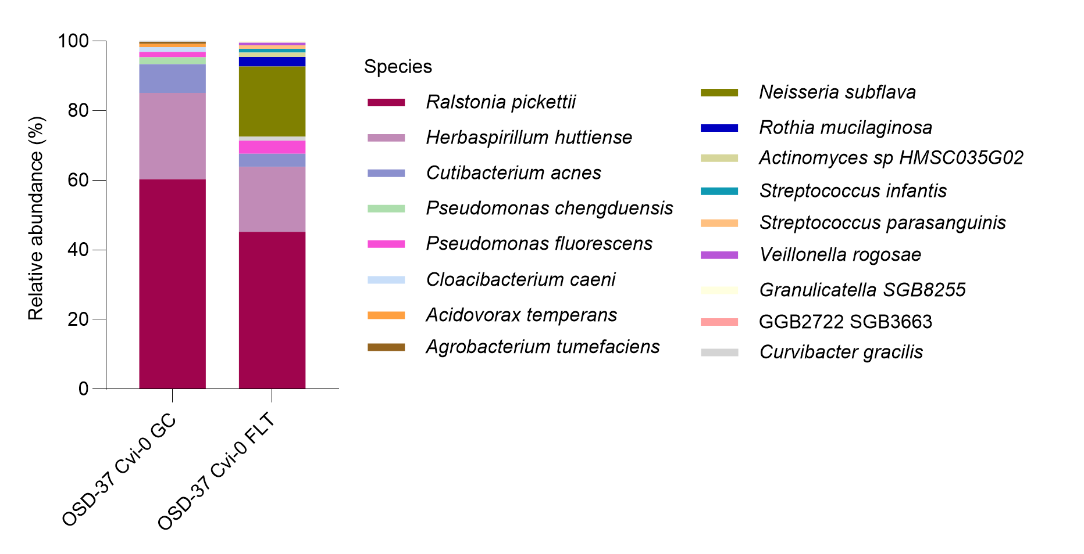
Bacteria - Cvi-0 (GC-FLT)
e)
f)
https://www.nature.com/articles/nmeth.2066

Slide 20
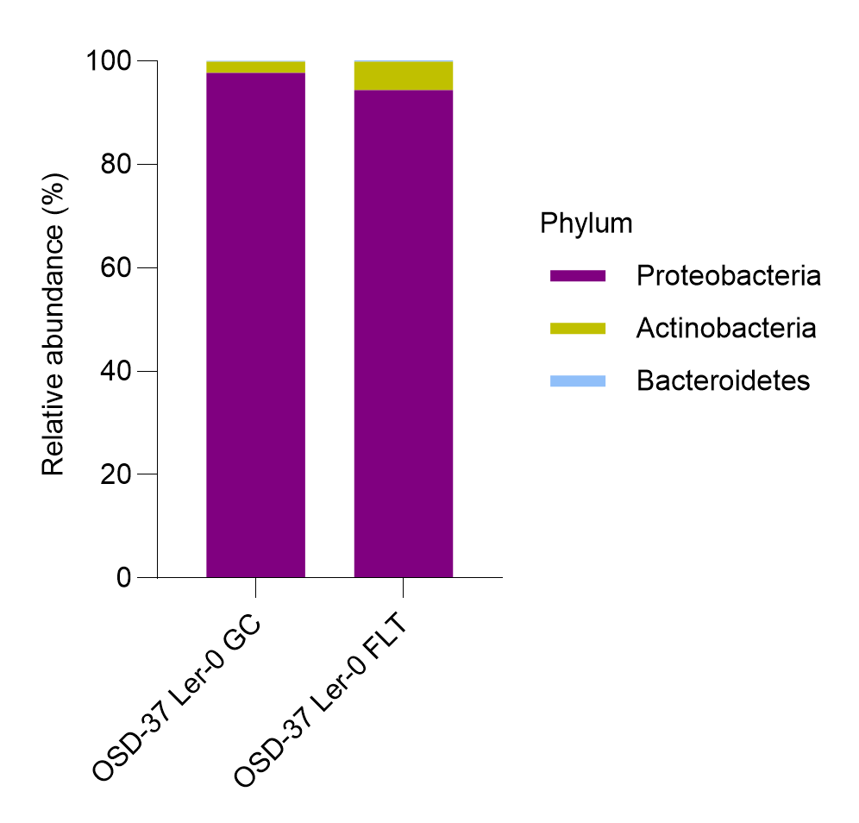
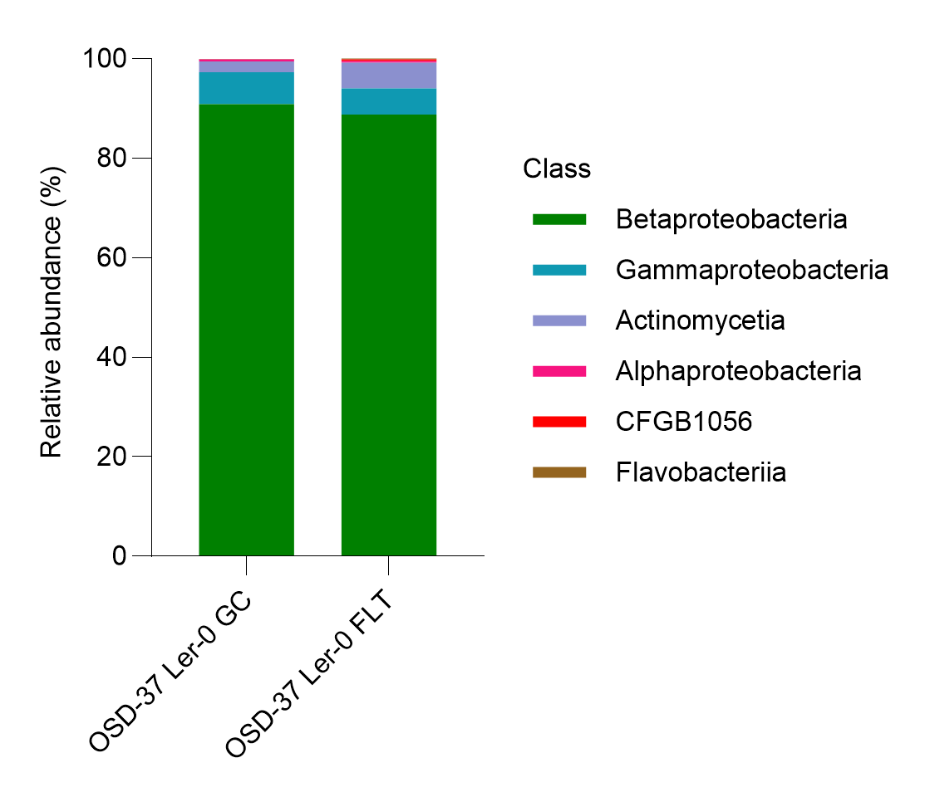
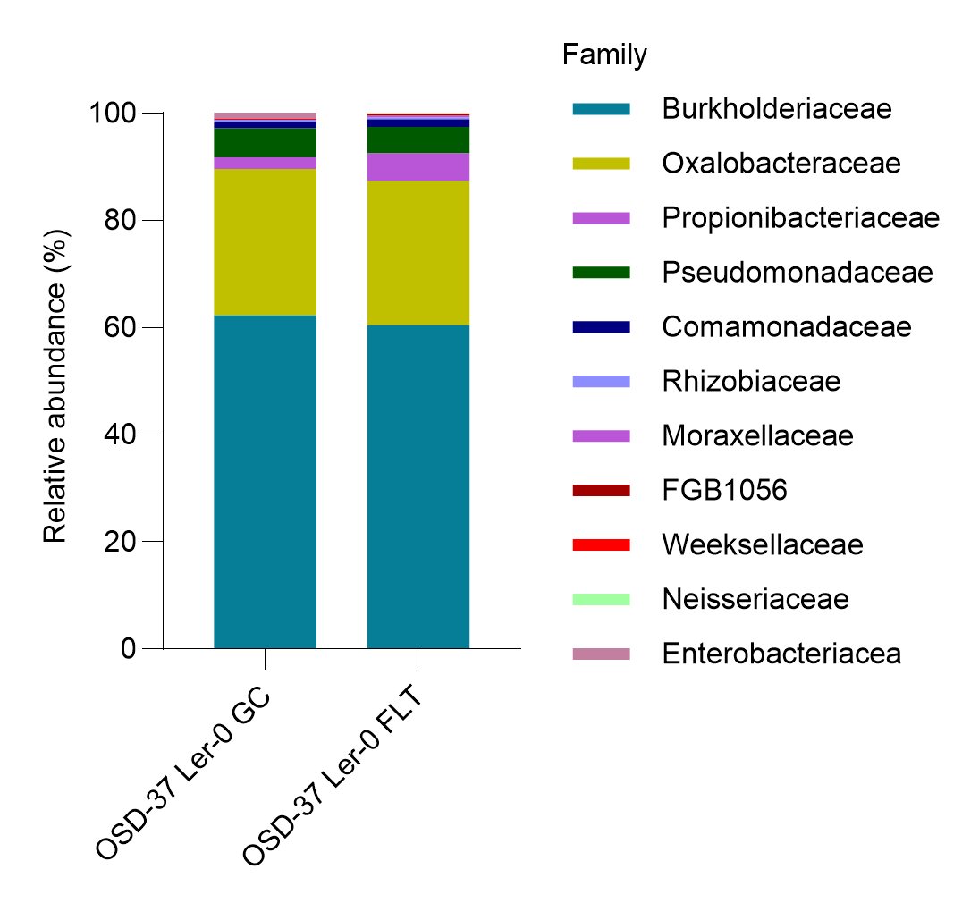
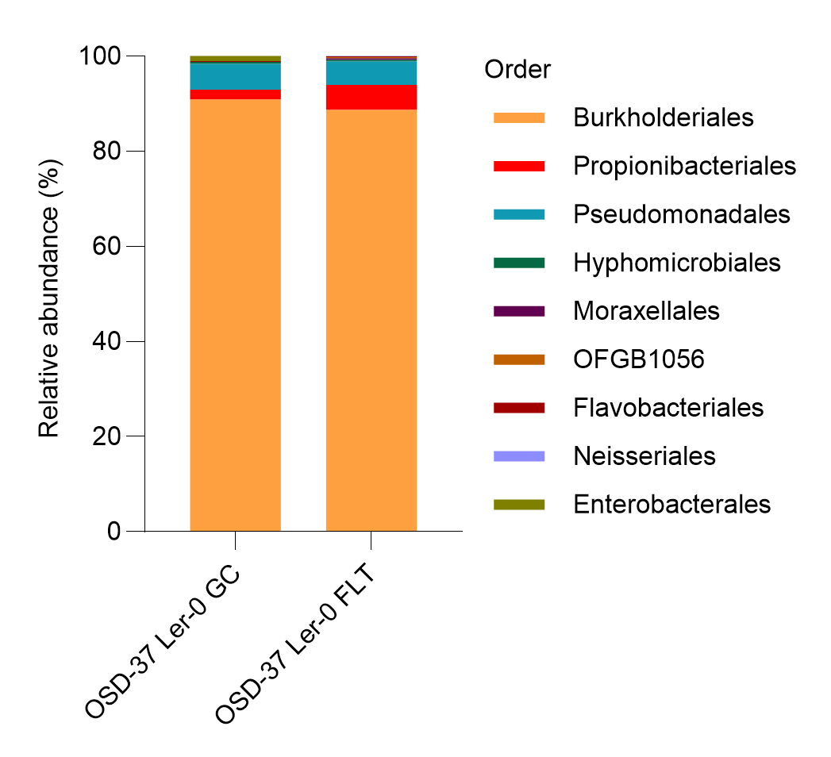
Bacteria - Ler-0 (GC-FLT)
a)
b)
c)
d)
https://www.nature.com/articles/nmeth.2066

Slide 21
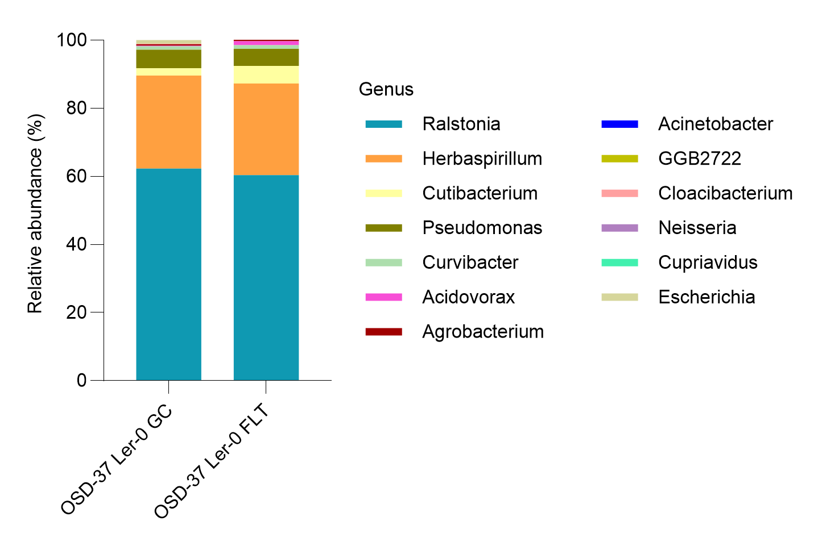
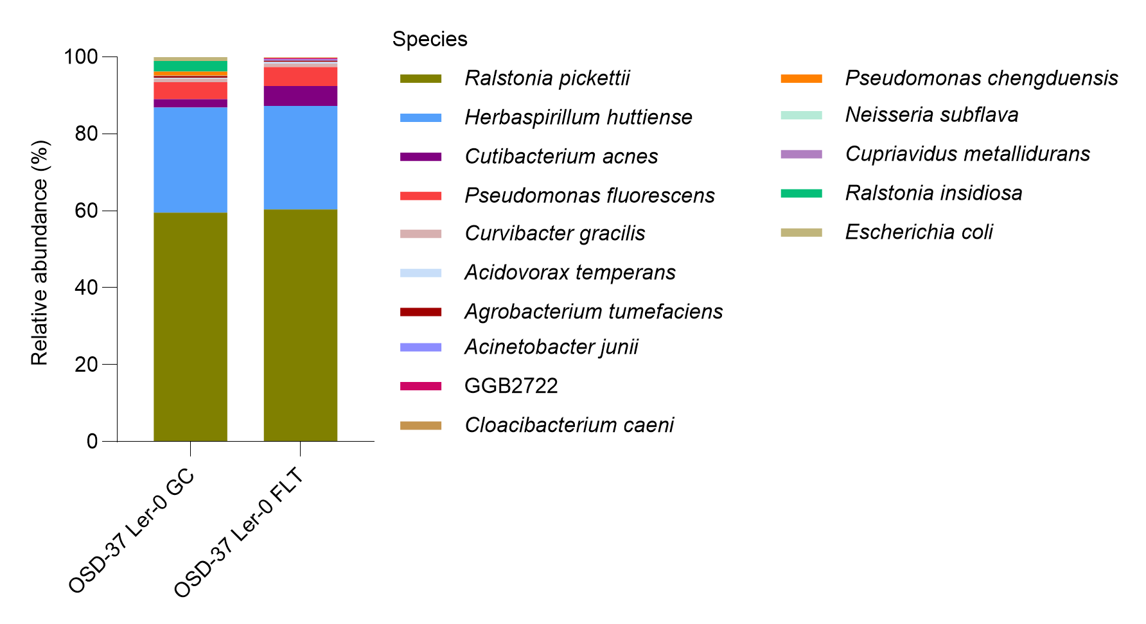
Bacteria - Ler-0 (GC-FLT)
e)
f)
https://www.nature.com/articles/nmeth.2066

Slide 22
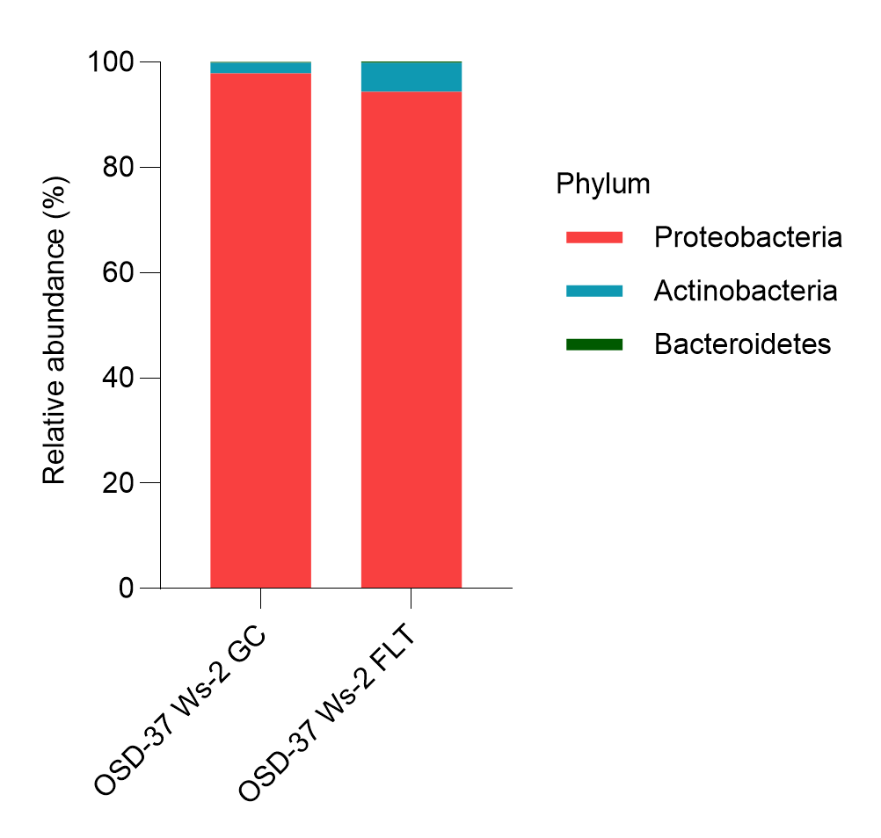
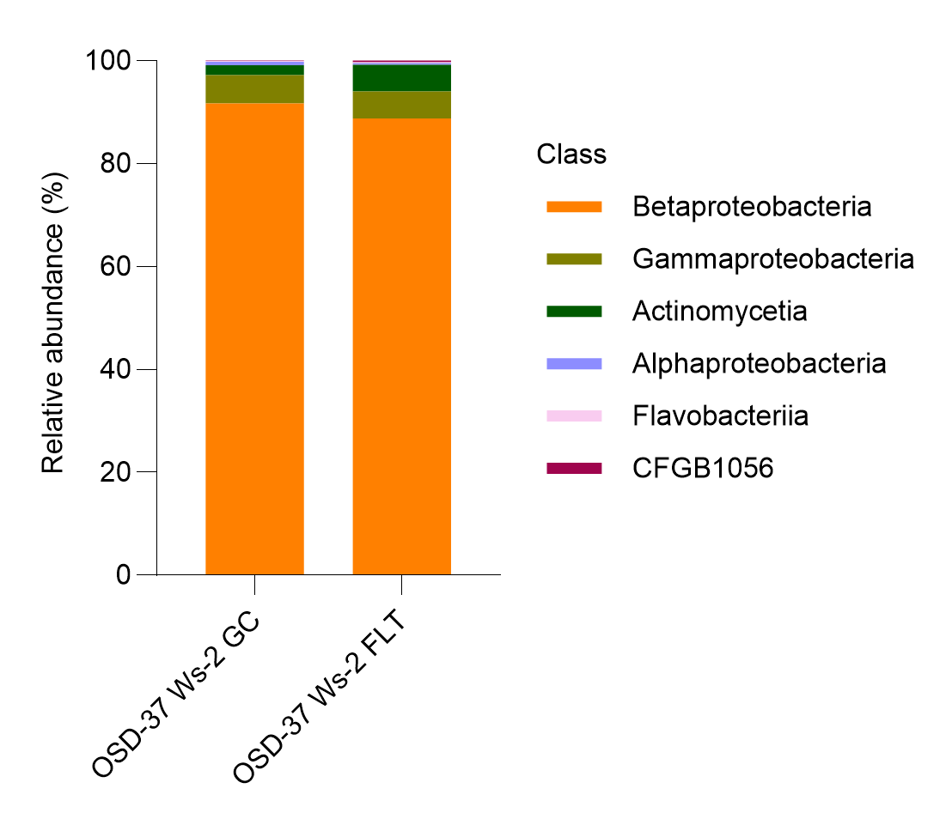
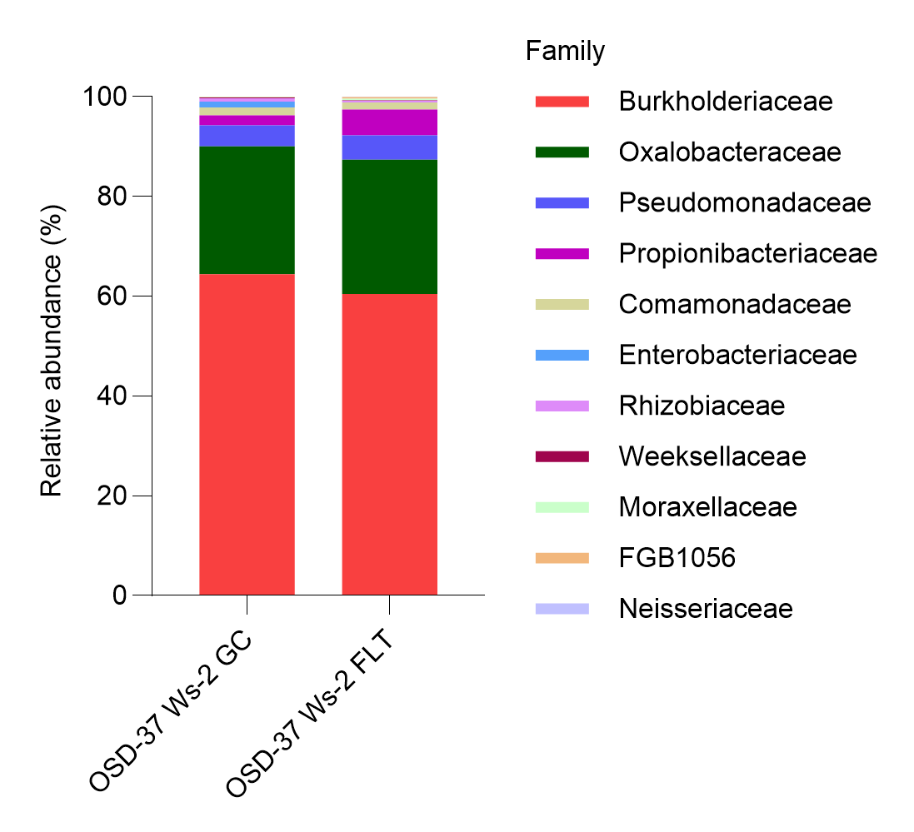
Bacteria - Ws-2 (GC-FLT)
a)
b)
c)
d)
https://www.nature.com/articles/nmeth.2066

Slide 23
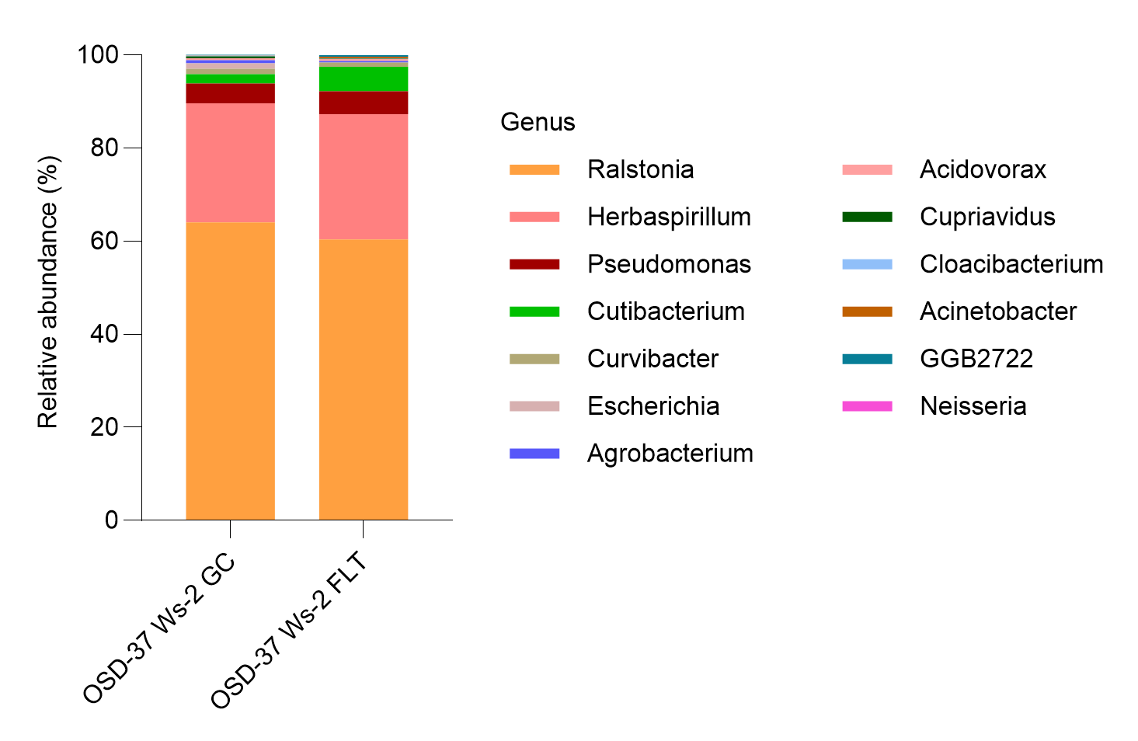
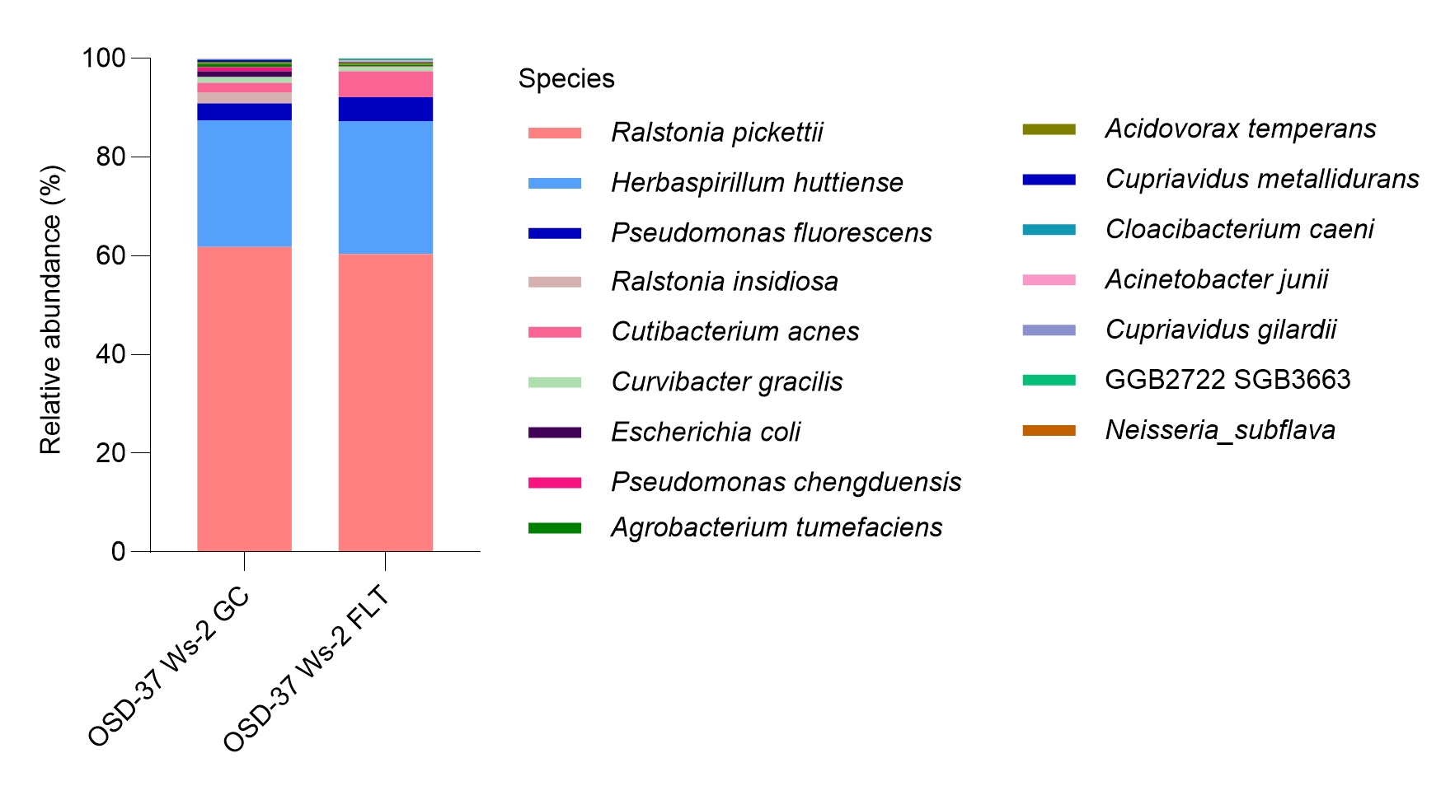
Bacteria - Ws-2 (GC-FLT)
e)
f)
https://www.nature.com/articles/nmeth.2066

Slide 24
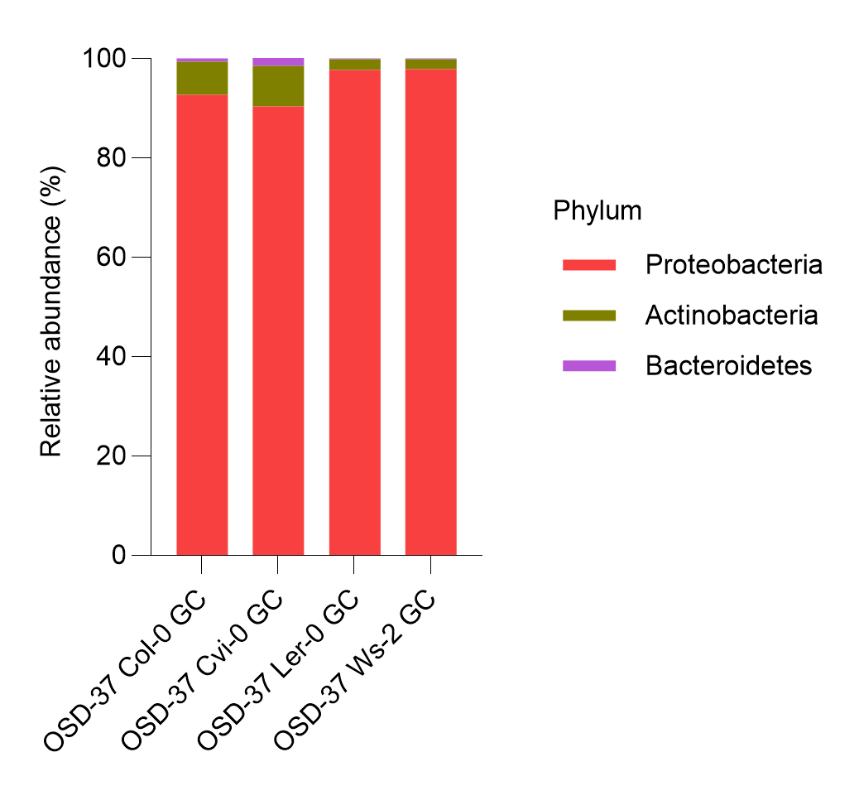
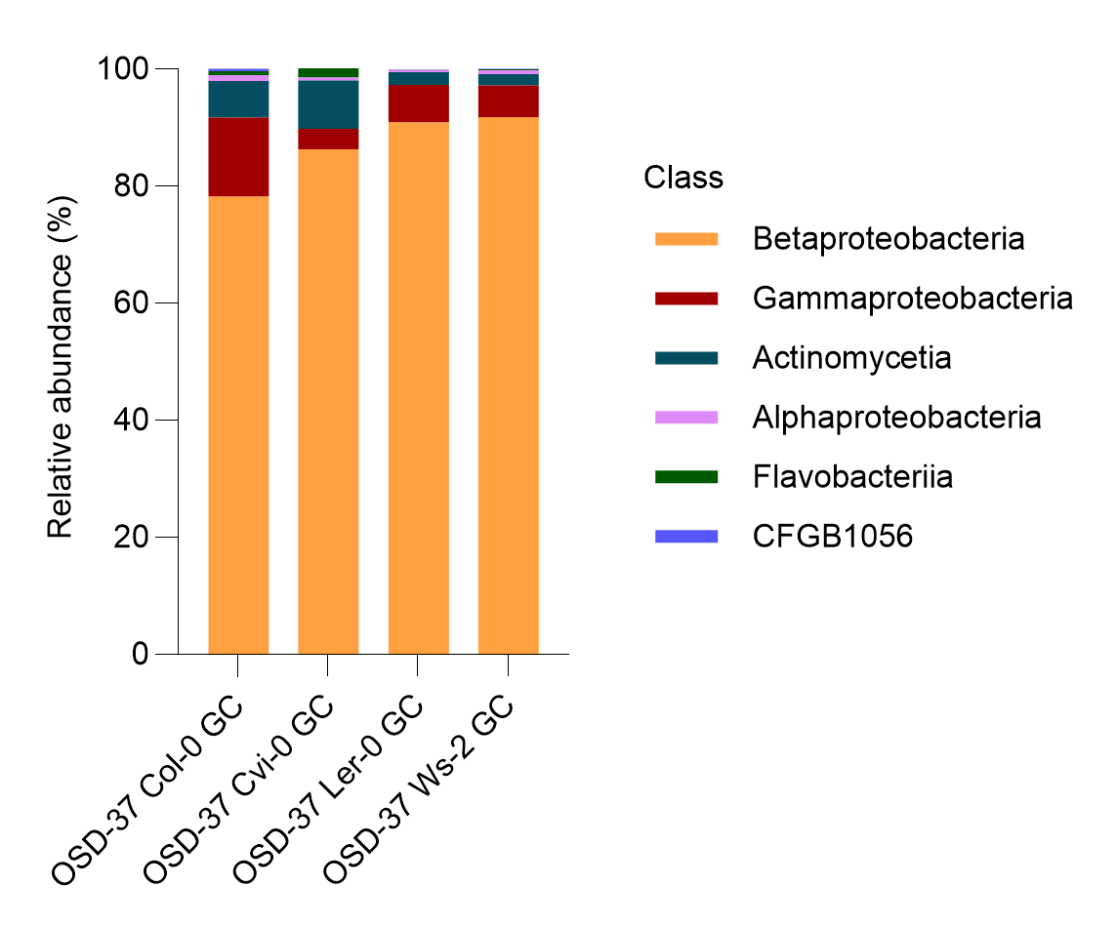
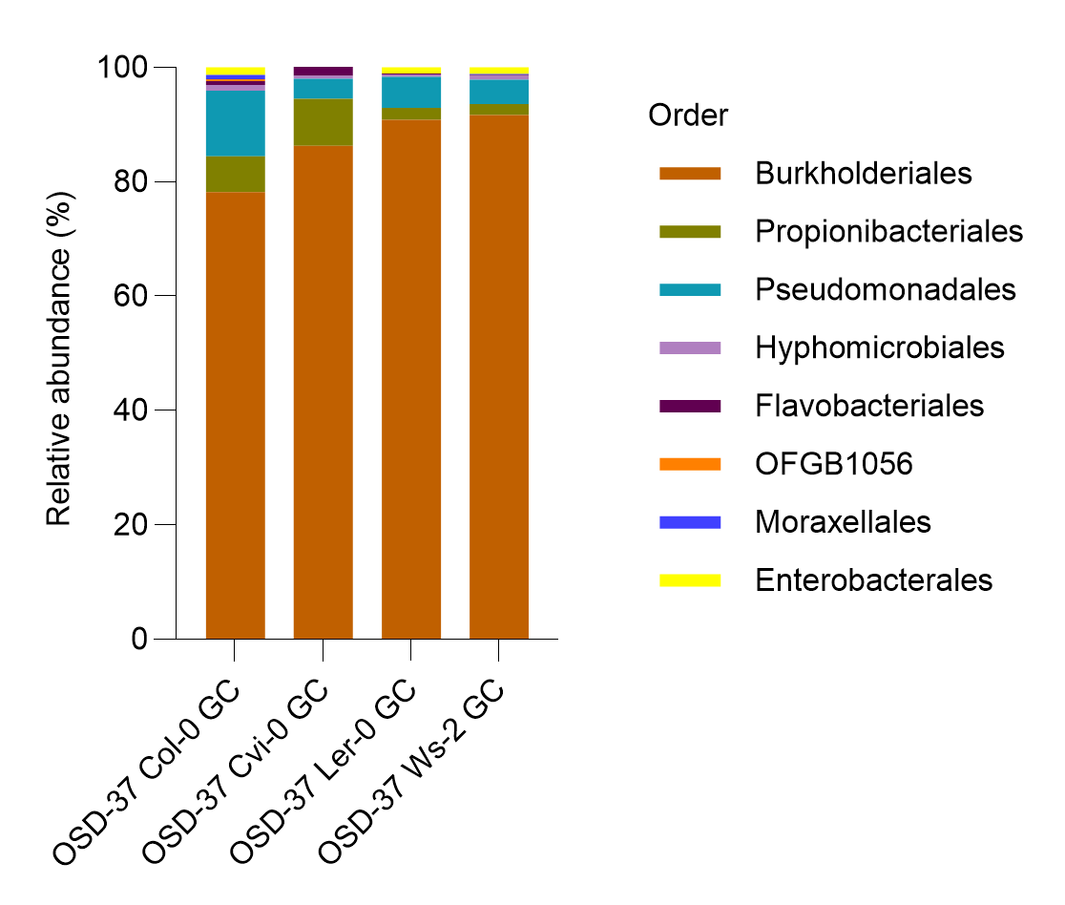
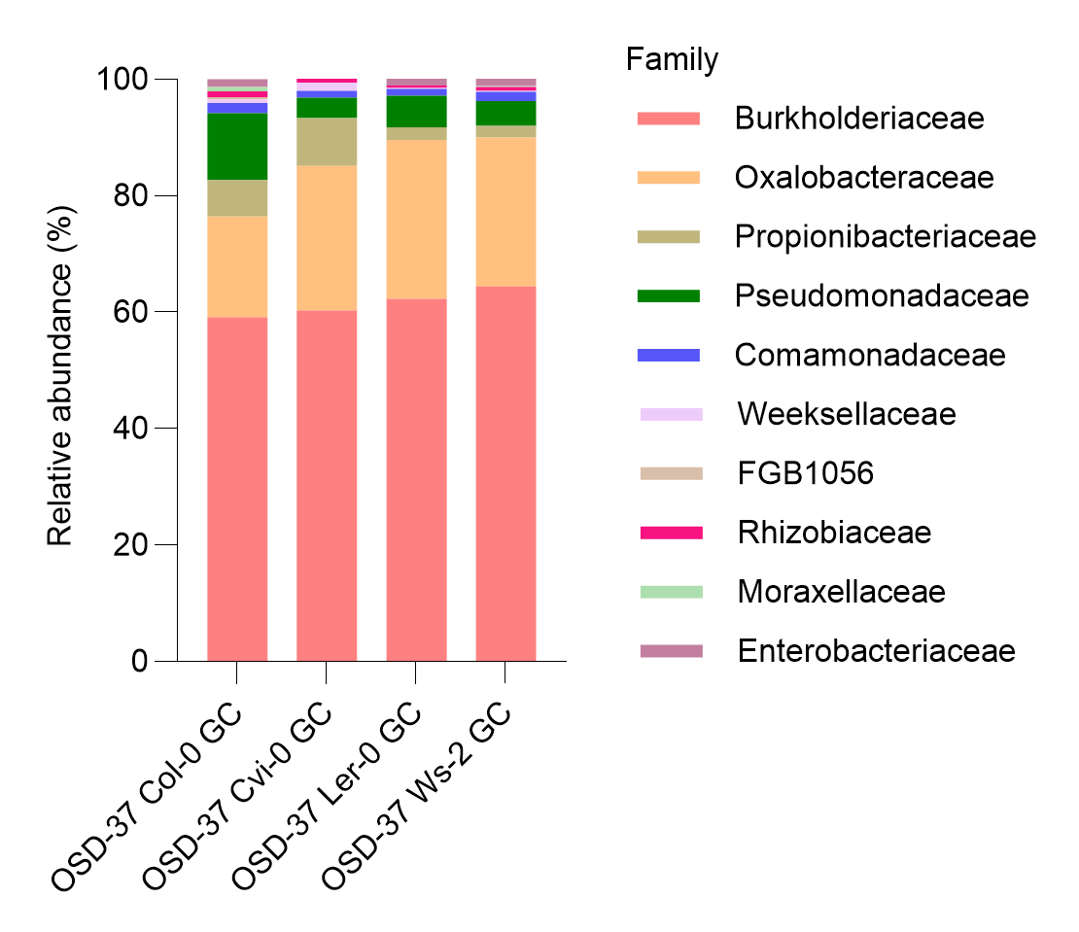
Bacteria – OSD-37 GC
a)
b)
c)
d)
https://www.nature.com/articles/nmeth.2066

Slide 25
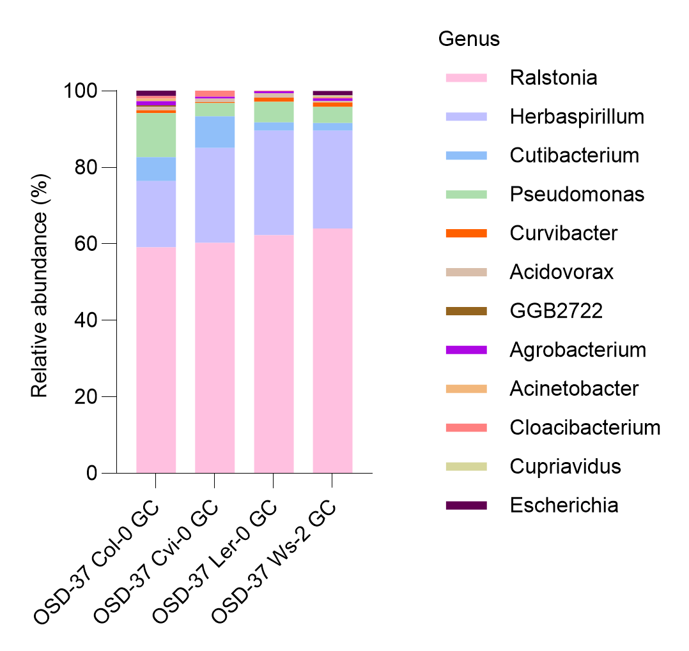
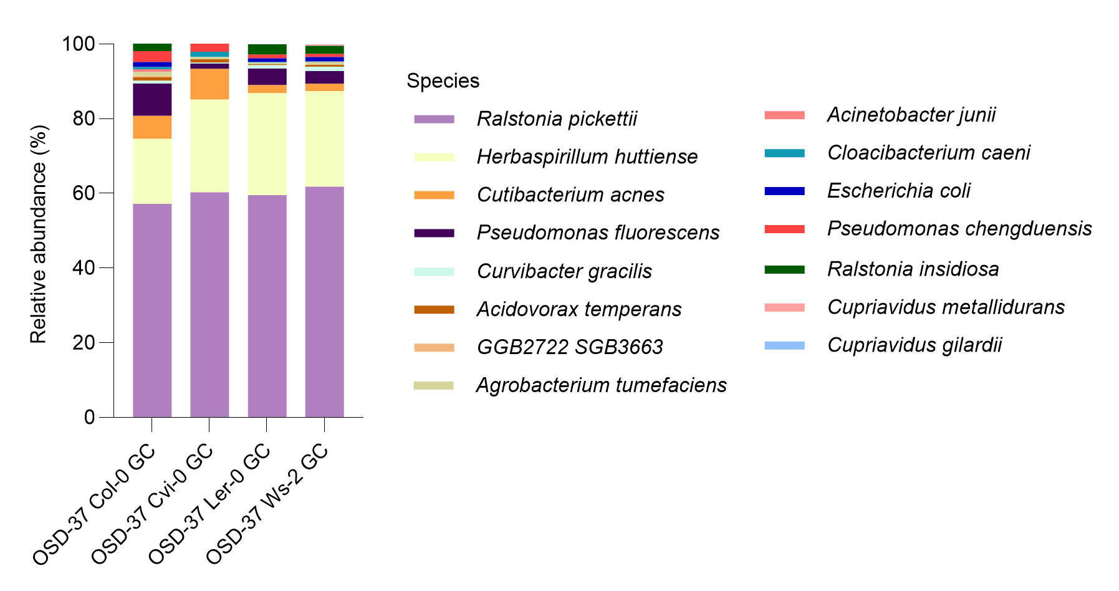
Bacteria – OSD-37 GC
e)
f)
https://www.nature.com/articles/nmeth.2066

Slide 26
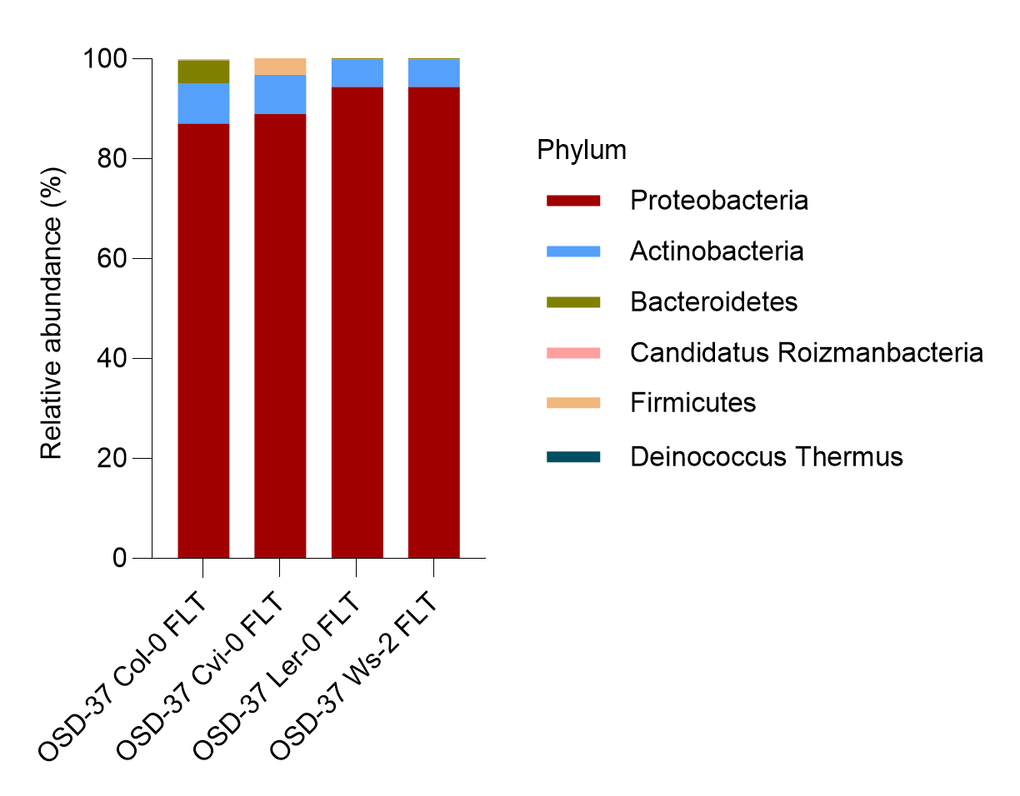
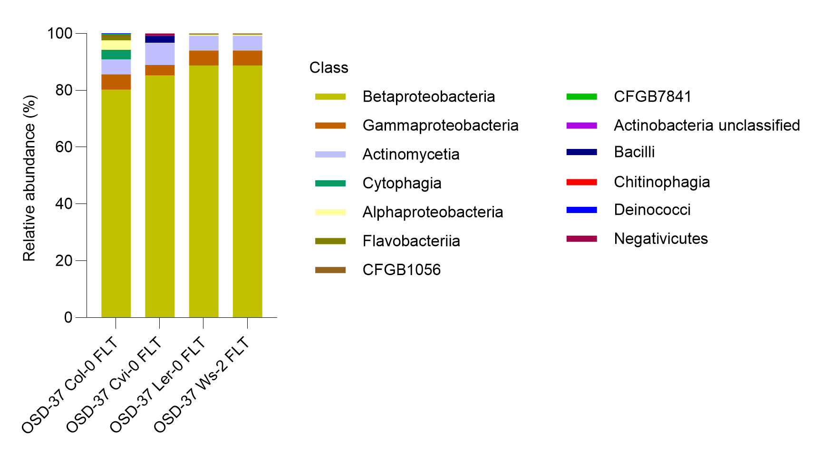
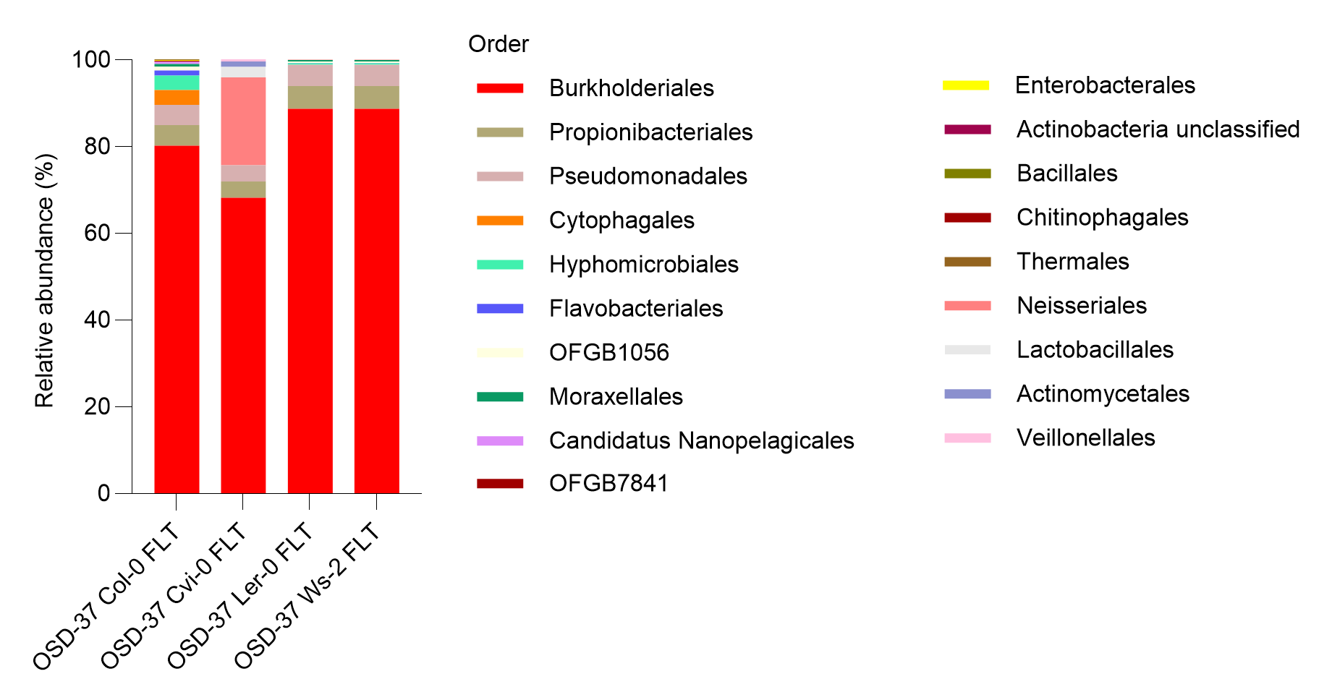
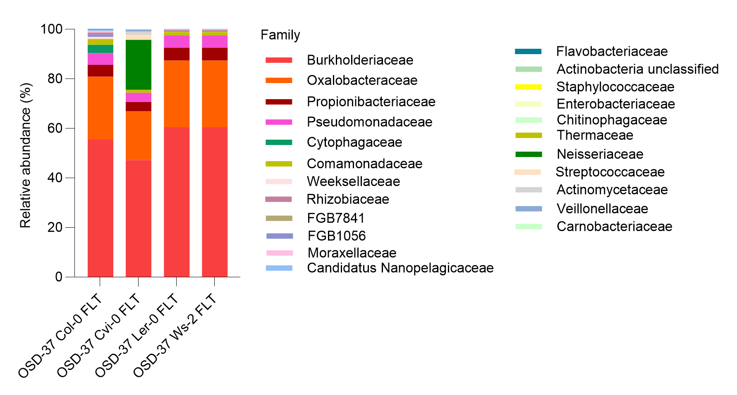
Bacteria – OSD-37 FLT
a)
b)
c)
d)
https://www.nature.com/articles/nmeth.2066

Slide 27
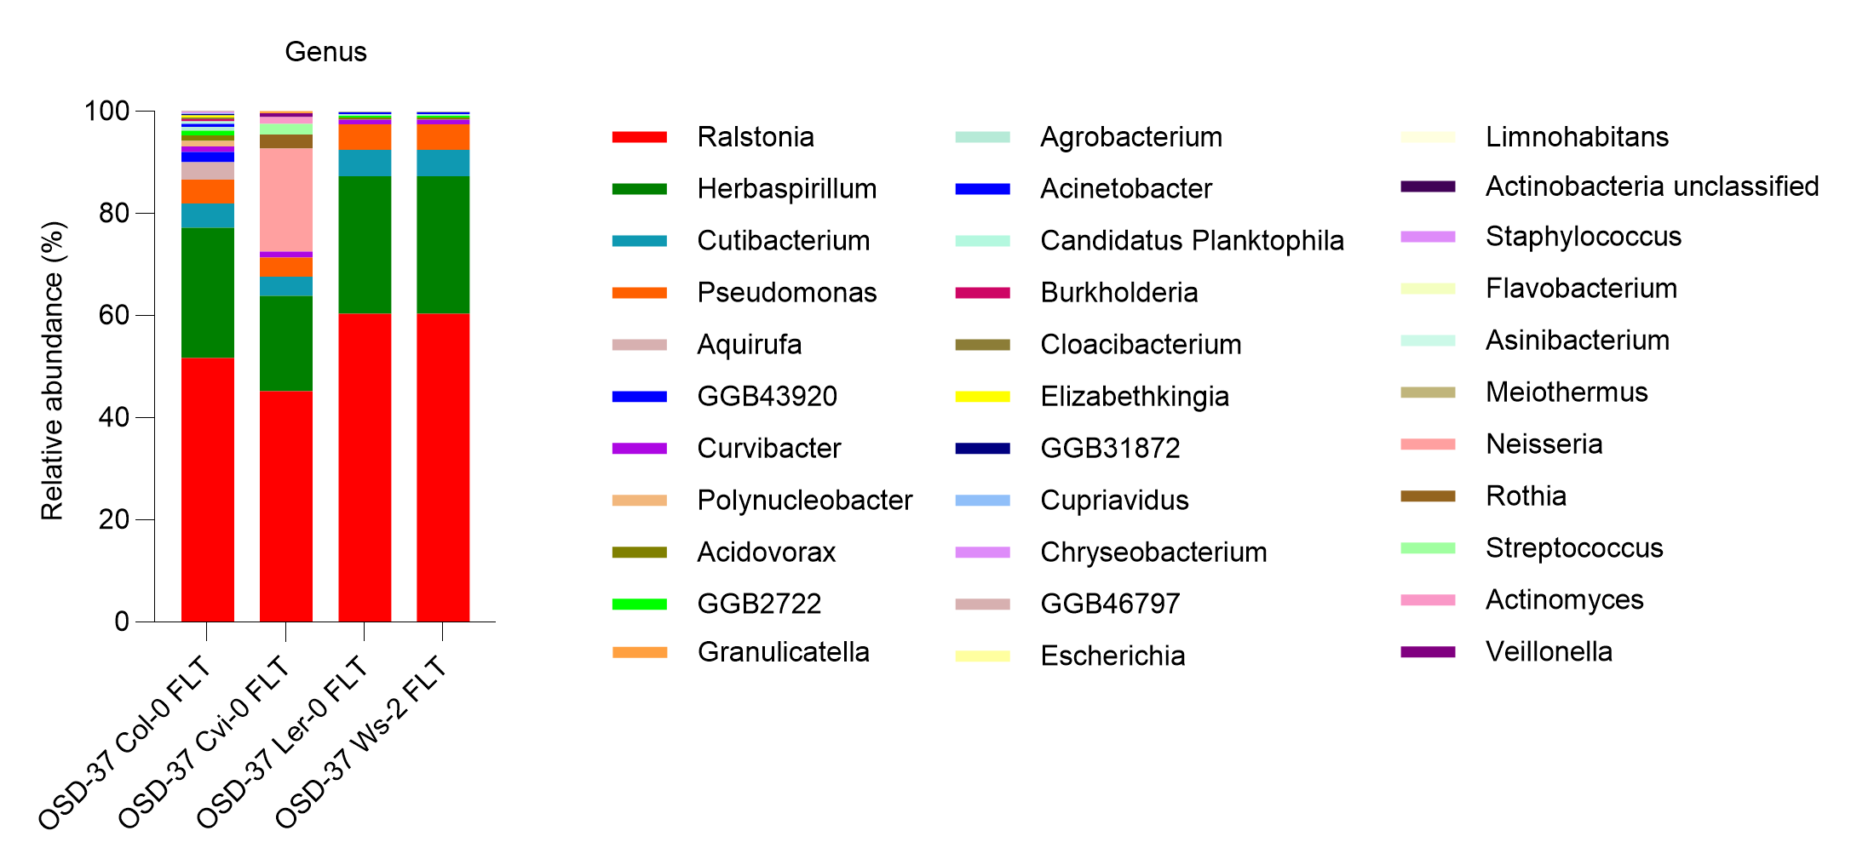
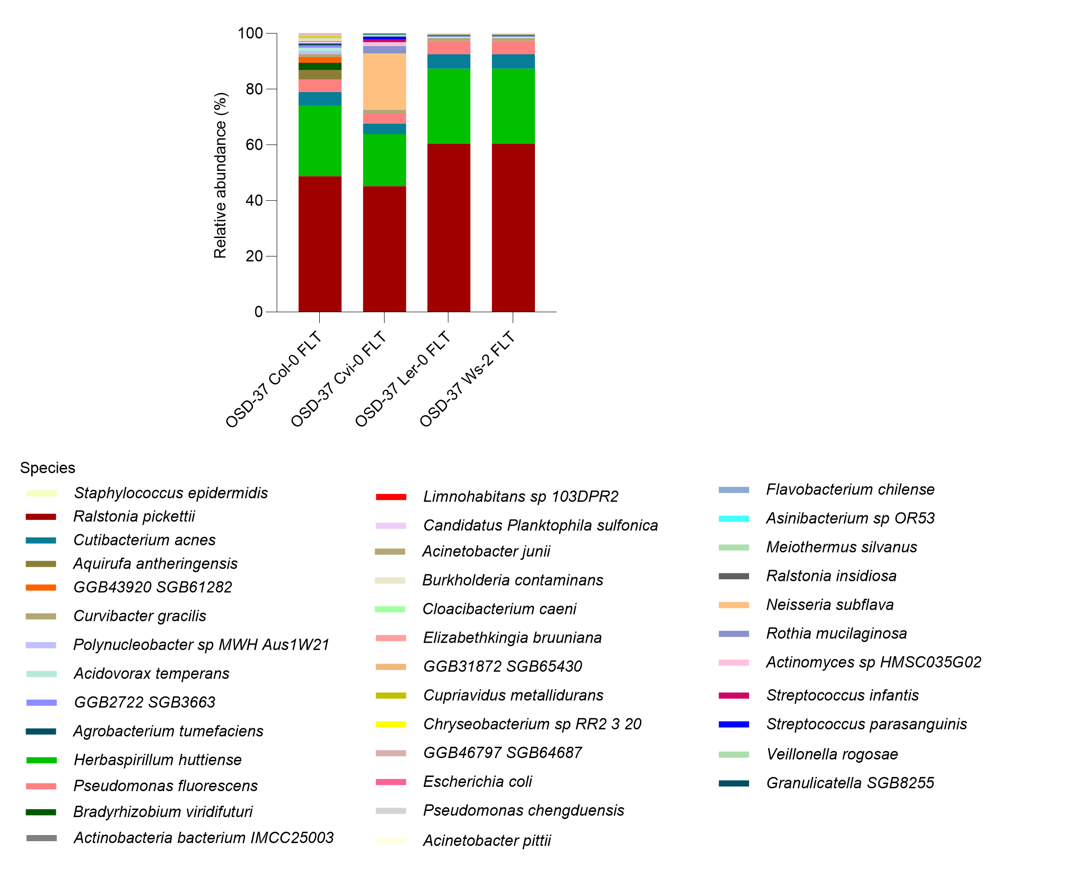
Bacteria – OSD-37 FLT
e)
f)
https://www.nature.com/articles/nmeth.2066

Slide 28
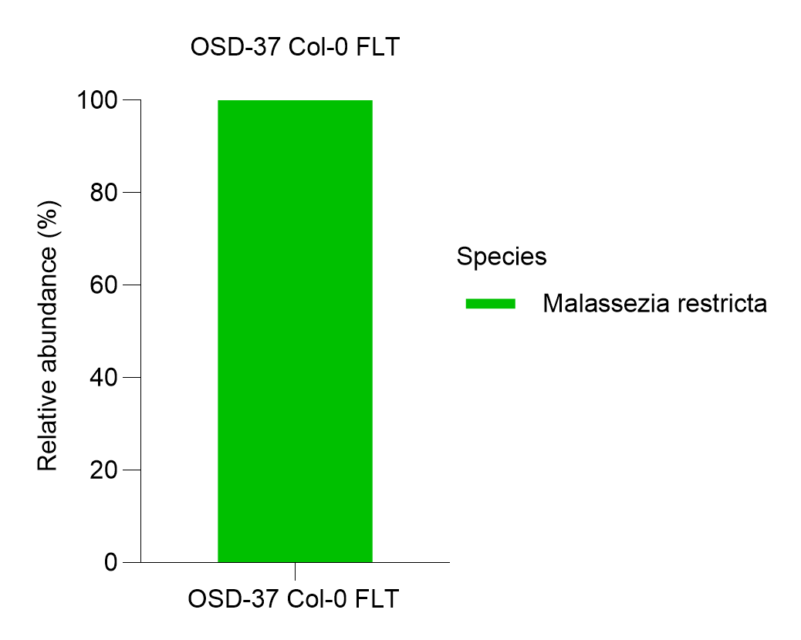
Result
The composition of the endophytic bacterial and fungal communities
We performed relative abundance analysis to elucidate the unique microbial communities associated with Arabidopsis thaliana. This approach allows us to delineate the distinct microbial signatures that differentiate Arabidopsis thaliana, emphasizing the comparisons for understanding microbial diversity. Our findings reveal that bacterial communities belonging to the Genus level Ralstonia and Herbaspirillium were abundant in OSD-37 Col-0 (GC (59.1%)-FLT (51.7%)), Cvi-0 (GC (60.2%)-FLT (45.1%)), Ler-0 (GC (62.2%)-FLT (60.3%)), and Ws-2 (GC (64%)-FLT (60.3%)). Furthermore, only the fungal community Malassezia restricta belonging to the genus Malassezia (abundance ratios of 0.01%) showed abundance in OSD-37 Col- FLT.
Fungi
Malassezia restricta is commonly found on skin.

Slide 29
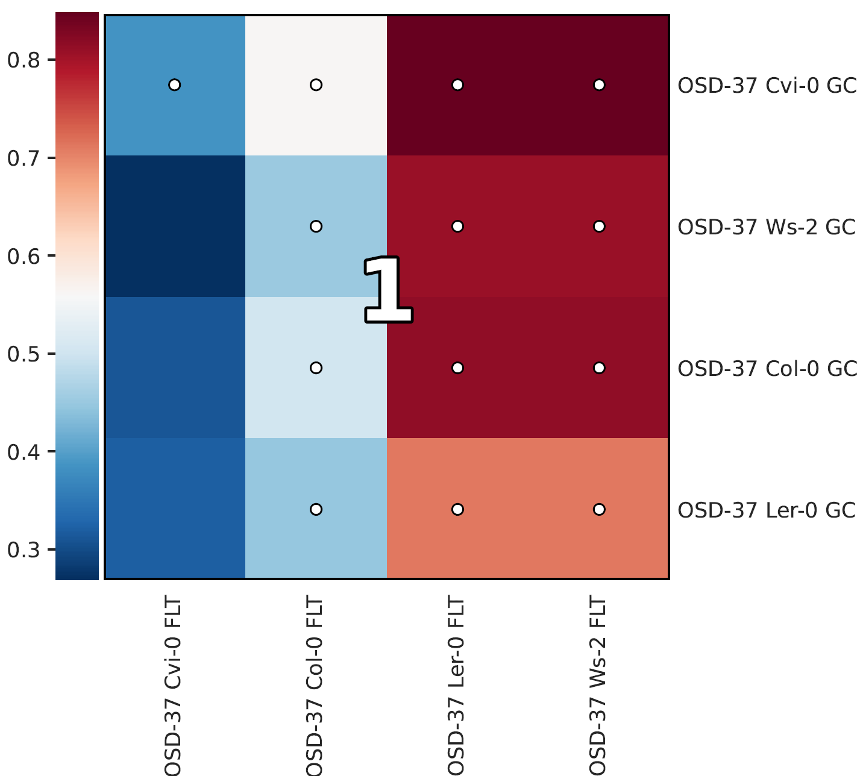
HAIIA (Hierarchical All-Against-All Association) analysis.
This study evaluated the relationships between Col-0 (GC-FLT), Cvi-0 (GC-FLT), Ler-0 (GC-FLT),and Ws-2 (GC-FLT) using Spearman correlation. A very strong positive correlation was determined between Col-0 GC, Cvi-0 GC, Ler-0 GC-,Ws-2 GC and Col-0 FLT, Cvi-0 FLT, Ler-0 FLT-,Ws-2 FLT (The false negative rate threshold was set at 20% and the false discovery rate threshold is set at 5%.).
https://pubmed.ncbi.nlm.nih.gov/35758795/

Slide 30
OSD-38
GC-Col-0, FLT-Col-0, RNAlat-Col-0, and LN2-Col-0

Slide 31
Bacteria
a)
b)
c)
d)
https://www.nature.com/articles/nmeth.2066

Slide 32
e)
f)
The composition of the endophytic bacterial communities
We performed relative abundance analysis to elucidate the unique microbial communities associated with Arabidopsis thaliana. This approach allows us to delineate the distinct microbial signatures that differentiate Arabidopsis thaliana, emphasizing the comparisons for understanding microbial diversity. Our findings reveal that RNAlat-Col-0 is characterized by a pronounced dominance of Bacillus (abundance ratios of 84.7%), LN2-Col-0 dominance of Weizmannia (abundance ratios of 79.8%), GC-Col-0 and FLT-Col-0 are the dominance of Synechococcus (abundance ratios of 75% and 71.7%, respectively), marking a distinct microbial profile.
https://www.nature.com/articles/nmeth.2066

Slide 33
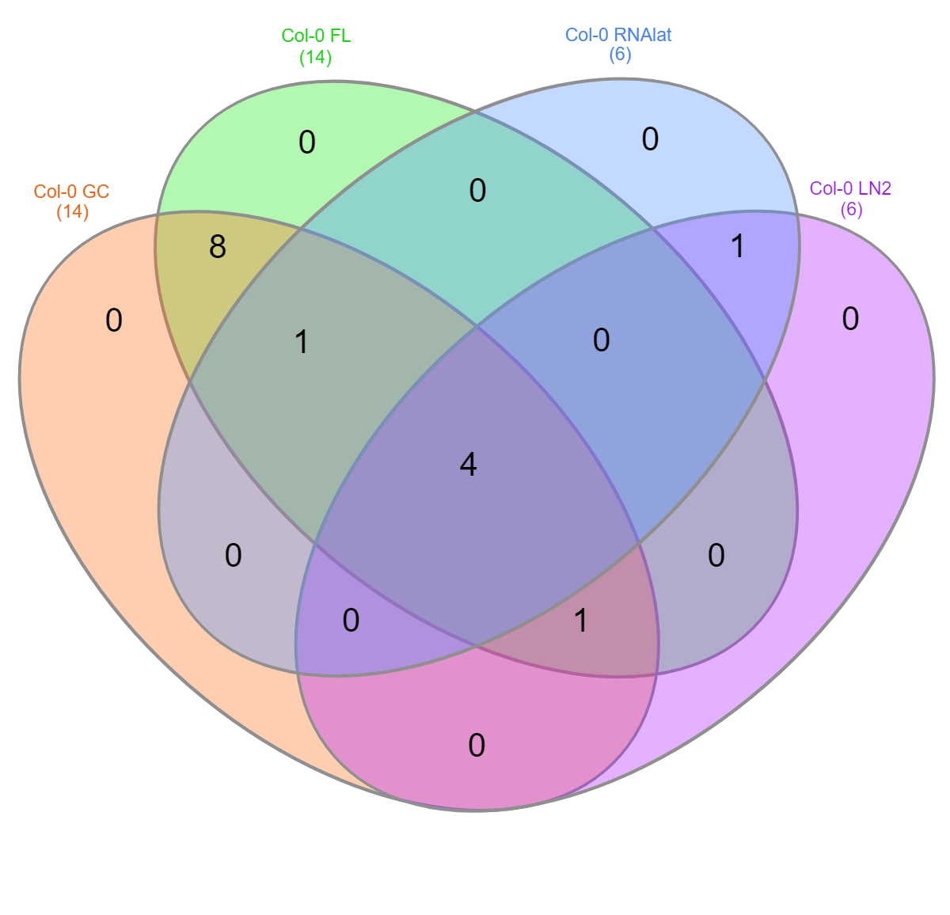

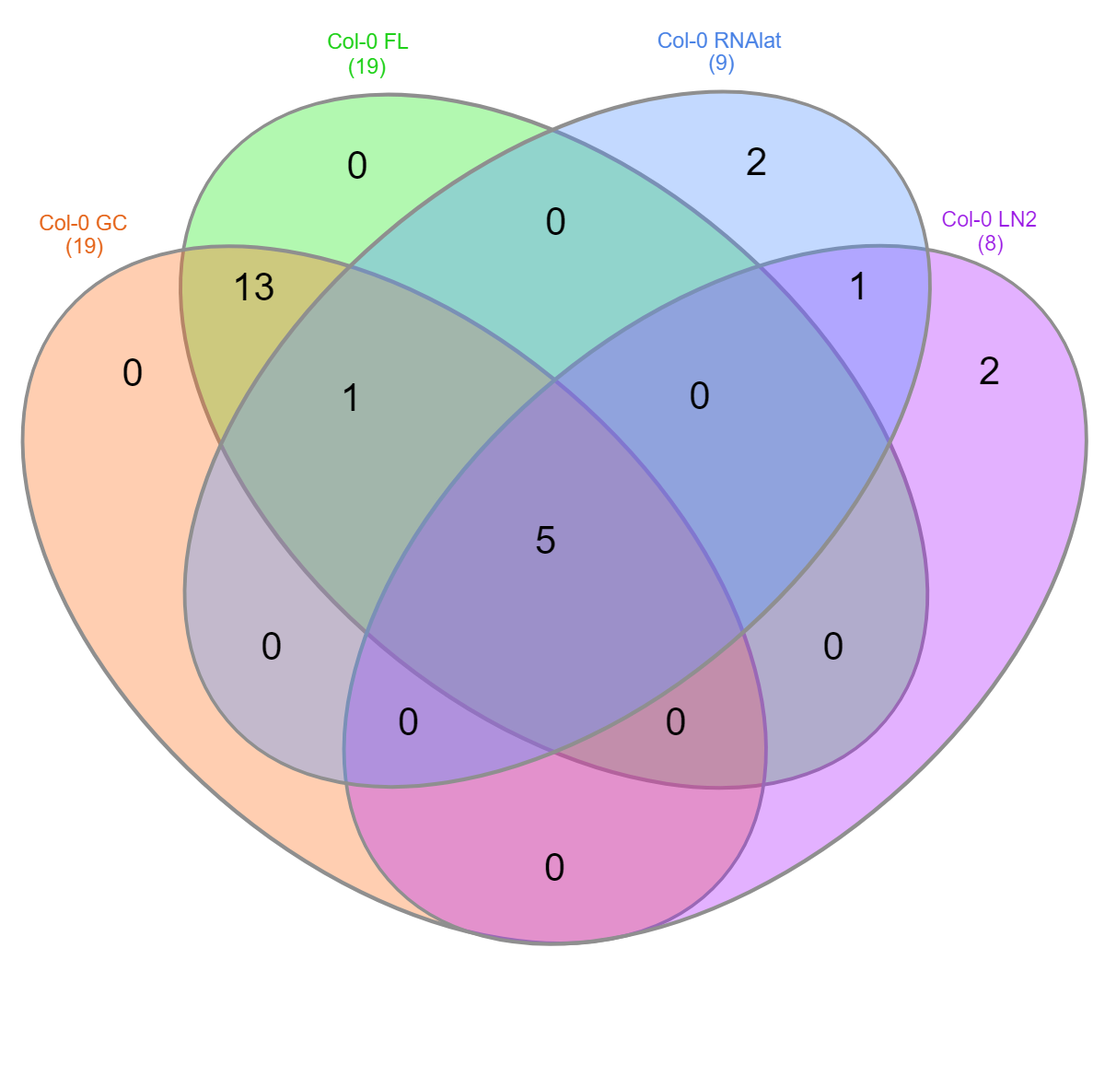
Bacteria
Family
Genus
Species
26.7%
26.3%
20.8%
Synechococcaceae
Comamonadaceae
Moraxellaceae
Propionibacteriaceae
Synechococcus
Comamonas
Acidovorax
Acinetobacter
Cutibacterium
Synechococcus elongatus
Comamonas denitrificans
Acidovorax ebreus
Acinetobacter junii
Cutibacterium acnes
Venn diagram for GC-Col-0, FLT-Col-0, RNAlat-Col-0, and LN2-Col-0
A Venn diagram represents the percentage and number of shared and unique microbiomes in the bacterial communities of the GC-Col-0, FLT-Col-0, RNAlat-Col-0, and LN2-Col-0 in the family, genus, and species level.
https://bmcbioinformatics.biomedcentral.com/articles/10.1186/s12859-015-0611-3

Slide 34
Bacteria
Alpha diversity comparisons of the Arabidopsis thaliana
The p-values for alpha diversity were calculated using the Kruskal-Wallis test. Alpha diversity for bacterial communities in different accessions of GC-Col-0, FLT-Col-0, RNAlat-Col-0, and LN2-Col-0 at the species level. There is no statistically significant difference between the groups in terms of alpha diversity. The groups have similar alpha diversity levels.
H.J. Motulsky, Analyzing Data with GraphPad Prism, 1999,. GraphPad Software Inc.

Slide 35
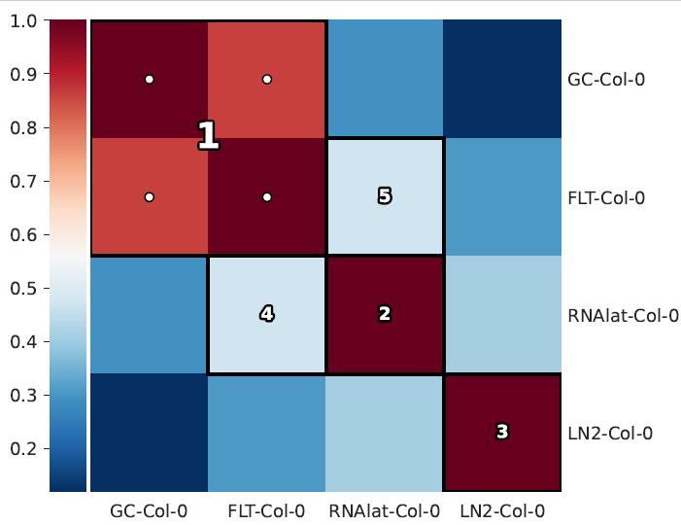
Bacteria
HAIIA (Hierarchical All-Against-All Association) analysis.
This study evaluated the relationships between GC-Col-0, FLT-Col-0, RNAlat-Col-0, and LN2-Col-0 using Spearman correlation. A very strong positive correlation was determined between GC-Col-0 and FLT-Col-0, and these two GC-Col-0 and FLT-Col-0 tended to increase or decrease together. Furthermore, RNAlat-Col-0 was moderately positively correlated with FLT-Col-0 and GC-Col-0. LN2-Col-0 had weaker but significant positive correlations with RNAlat-Col-0 and GC-Col-0.
https://pubmed.ncbi.nlm.nih.gov/35758795/

Slide 36
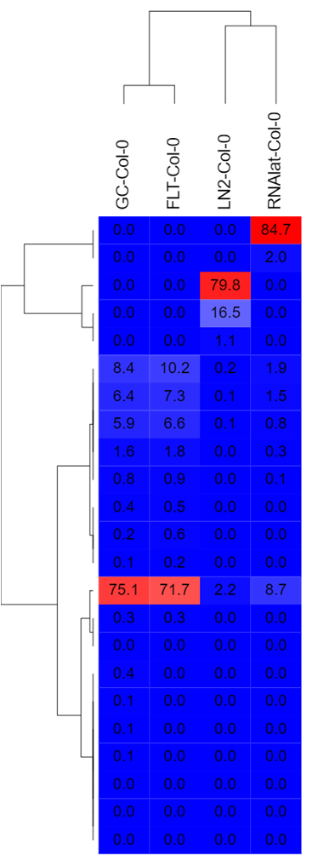
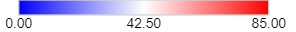
Bacteria
Bacillus subtilis
Weizmannia ginsengihumi
A heatmap was performed using Spearman correlation analysis to assess the relationships between specific variables.
RNAlat-Col-0 with Bacillus subtilis, LN2-Col-0 with Weizmannia ginsengihumi, GC-Col-0, and FLT-Col-0 with Synechococcus elongatus show a strong link between the variables.
Synechococcus elongatus
https://software.broadinstitute.org/GENE-E/

Slide 37
Fungi
a)
The composition of the endophytic fungal communities
Only GC-Col-0 and FLT-Col-0 were found to have a fungal community of Malassesiza restirica belonging to the genus Malassezia.
https://www.nature.com/articles/nmeth.2066

Slide 38
OSD-217

Slide 39
Bacteria – OSD-217 FLT Leaf and FLT Root
a)
b)
c)
Bacteria – OSD-217 GC Leaf and GC Root
a)
b)
c)

Slide 40
Bacteria – OSD-217 FLT Leaf and GC Leaf
a)
b)
c)
Bacteria – OSD-217 FLT Root and GC Root
a)
b)
c)

Slide 41
OSD-522

Slide 42
Bacteria – OSD-522 GC-FT
a)
b)
c)

